Slide 1
FirstNet Update
Kevin McGinnis
FirstNet Board Member
November 13, 2014

Slide 2
Technology Update

Slide 3
PSCR QoS/Priority/Pre-Emption Testing Update
QoS/Priority/Pre-Emption Features
What is working? Priority pre-emption of bearers ARP and QCI basic configuration Basic admission control Basic packet scheduling
What is under investigation? Preemption triggers Impacts to cell capacity and performance
What needs development by the vendors? Establishment cause support Multi-media priority service SIP priority
Major PSCR Lab Activities
Vendor Integration 5 EPC vendors engaged 2 integrated and under test 1 integrated, on hold for test 1 upgraded, on hold for integration 1 engaged, on hold for upgrade
Functional Evaluation System baseline established Integration briefing delivered (July) Focusing on ARP prioritization
PSCR adding staff to support multi-vendor evaluation (target onboarding in September)
Defects and feature support in RAN load testing equipment posing a challenge
Starting to see some wins in the area of preemption. Successful triggering of preemption observed after system default parameter optimization
Basic QoS/P/P features are working. PSCR will share test plan and encourage parallel testing with vendors
Advance features need development (Multimedia Priority Services, Establishment Cause support)

Slide 4
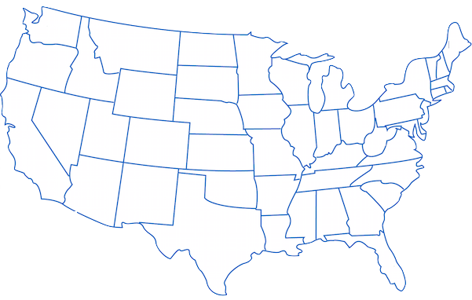
Public Safety LTE Deployments
FirstNet Guiding Principle
FirstNet will provide technical support to these projects and will share any lessons learned with the broader public safety community to inform FirstNet’s nationwide deployment
3
4
1
2
5
Project | SMLA | KLCP | Sites | Primary Focus Area(s)/Key Learnings | On-Air
1. LA-RICS | Yes | Yes | 231 | Secondary responders, Quality of Service, priority/pre-emption | 2Q15
2. NM | Yes | Yes | 9 | Hosted core, int’l border spectrum management, federal partnerships | 2Q15
3. NJ | Yes | Yes | 31 | Deployable assets, DR/COOP, training exercises, NOC notification | 2Q15
4. ADCOM | Yes | In-Progress | 17 | PSCR/FirstNet test support, BC 14 device testing, demonstration access | Now
5. TX | Yes | In-Progress | 13 | Core migration, user data analytics, use cases | Now
SMLA: Spectrum Manager Lease Agreement
KLCP: Key Learning Conditions Plan

Slide 5
State Consultation and State Plans

Slide 6
Updated State Consultation Approach
Preparation
Initial Consultation
RFP Evaluation Data Collection
Draft State Plan Review
Final State Plan Review
Phase 1 Implementation
RFI
RFI/RFP Public Comments
RFP Development
RFP Evaluation
RFP Results
FirstNet Acquisition
Prep Workshops (OEC, Regional, State/Local)
Users / Coverage / Outreach
Review State Results & Priorities
Draft Plan
Final State Plan
Network Implementation
Consultation
PSAC / FCC Inputs
Operations
(Provisioning, Training, Priority, Hardening, Security)
Stakeholder Input
Outreach / Education
■ PSAC  Tribal Working Group  NTIA SLIGP Monitoring/Support  ECPC Federal Agency Inputs

Slide 7
State Plan Overview
Requirements
Completion of the RFP process
Document proposed build-out in the State
Funding level for the State
Stakeholder
Relationships
Users
Assets
Coverage
Design
Capacity
Contracts
Governance

Slide 8
Tracker – State Consultation Activities As of November 13, 2014
WA
AK
ME
MT
ND
OR
MN
VT
State | Meet
MD | 7-29-2014
MN | 9-24-2014
OR | 10-08-2014
WA | 10-16-2014
MT | 10-29-2014
UT | 11-06-2014
PR | 11-12-2014
IA | 11-18-2014
FL | 12-12-2014
SD
NH
ID
WI
NY
MA
WY
MI
CT
NE
IA
PA
DC
DE
MD
RI
NV
OH
NJ
UT
IL
IN
CA
CO
WV
VA
KS
MO
KY
TN
NC
AZ
NM
OK
AR
SC
HI
MS
AL
GA
MP / CNMI
TX
LA
GU
AS
FL
LEGEND
All
1) Received Initial Consultation
Package from FirstNet
30
3) Initial Consultation Checklist returned to FirstNet
2
5) Remaining Initial Consultation meetings scheduled in 2014
PR
44
2) Pre-consultation conference
call scheduled or closed
7
4) Initial Consultation meeting
held with FirstNet
6) Additional Initial Consultation
Meeting being scheduled in 2014
VI
0

Slide 9
Key Findings and Topics
7 States evaluated: MD, MN, OR, WA, MT, UT, PR
Approximate number of participants: 570. Average number per state: 81
Use cases discussed included:
Recurring topics of interest:
Mall shooting
Wild fire
National level sporting event
Bridge collapse over water
Building Fire
Mudslide
Fugitive tracking
Super Bowl parade
Flooding
Hospital shooting
Affordability
Rural coverage
Coordination with federal agencies
Geo-fencing
Cyber security
Deployables
Tribal coverage
Use of existing assets

Slide 10
RFI and Public Notice and Comment Preliminary Summary

Slide 11
Initial Results
Request for Information (RFI) with a draft Statement of Objectives (SOO)
122 confidential responses received by October 27 deadline
Public Notice and Comment
64 public responses received by October 27 deadline
RFI/SOO and the Public Notice responses came from state and local governments; major public safety organizations and trade associations; and some private sector parties, including communications vendors and carriers serving both rural and non-rural areas.
Received extensive feedback on how best to structure our acquisition strategy for deploying an interoperable nationwide public safety broadband network.

Slide 12
Outreach

Slide 13
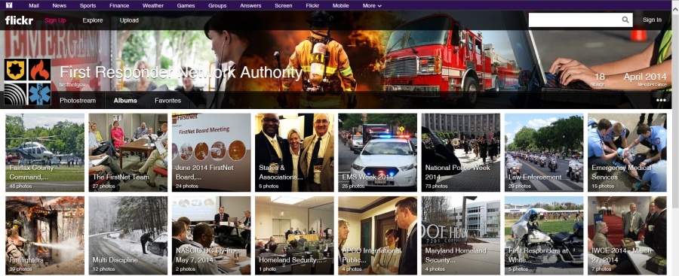
Stay Involved
FirstNet.gov website
Fact Sheets
Blogs
Presentations
Upcoming speaking engagements and current events
Board meeting materials and webcast
Social media presence
Twitter @firstnetgov
LinkedIn
YouTube (FirstNetGov)
Flickr (FirstNetGov)

Slide 14
Thank You

