Slide 1
SLIGP Update for NPSTC/IACP Public Safety Broadband Forum
June 24, 2014

Slide 2
BACKGROUND
The State and Local Implementation Grant Program (SLIGP) was created under the Middle Class Tax Relief and Job Creation Act of 2012
SLIGP is a three-year, formula-based grant program requiring 20% matching funds
Funding is to help recipients plan and prepare for the forthcoming nationwide public safety broadband network (PSBN)
NTIA awarded $116.2 million in grants to 53 states and territories with one additional grant forthcoming

Slide 3
PROGRAM GOALS
Grant funds assist states and territories to:
Support planning, governance, consultation, and outreach
Engage local governments, regional bodies, rural communities, and Tribal Nations
Reach out to all public safety disciplines that may be potential users of the PSBN
Collect data and gather information on existing infrastructure and equipment

Slide 4
SLIGP OUTCOMES
Enhance or establish statewide governance
Consult with FirstNet about unique characteristics of states and territories and the needs of public safety users
Identify potential users of the PSBN
Update Statewide Communications Interoperability Plans (SCIP) to include public safety wireless broadband initiatives
Collect data on existing infrastructure to help FirstNet plan for the PSBN

Slide 5
CURRENT RECIPIENT ACTIVITIES

Slide 6
CURRENT RECIPIENT ACTIVITIES

Slide 7
PROGRAM OFFICE ACTIVITIES
Two SLIGP regional workshops held in February and March were attended by:
State agency representatives from:
public safety or emergency management
grants and financial management
state IT/ telecommunications offices
outreach and public affairs
state broadband coordination offices
27 local and four tribal government reps
Of the attendees:
30 fill the role of designated Single Point of Contact (SPOC)
43 fill the role of Statewide Interoperability Coordinator (13 of the attendees fulfill both the role of SPOC and SWIC) for their state or territory
232
Total State and Territorial Attendees
124 108
Atlanta Phoenix

Slide 8
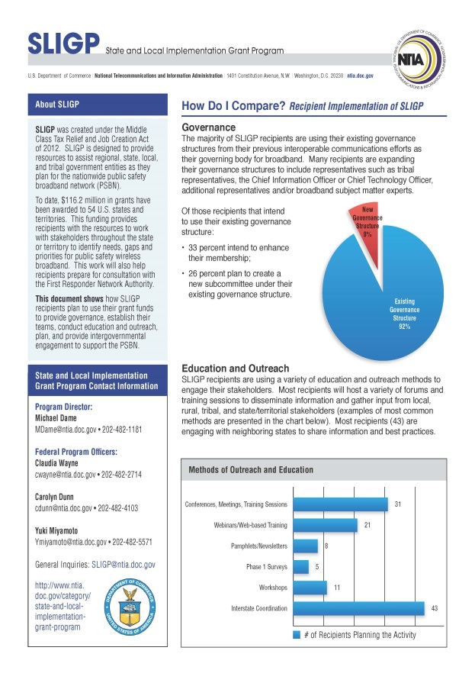
PROGRAM OFFICE ACTIVITIES
For the remainder of the year, SLIGP will:
Continue to provide support to our recipients
Develop and distribute programmatic best practices documents on program priorities such as outreach and education, tribal coordination, and governance
Conduct site visits (16 site visits planned for this year start this summer)
Hold webinars and conference calls as needed for programmatic refreshers or grants changes

Slide 9
HOW TO GET INVOLVED
Find out your designated SPOC
Determine what groups or associations are represented on the state/territory governing body
Learn how your state intends to execute education and outreach for public safety broadband and get involved
Attend PSBN outreach events
Help identify potential PSBN users
Support the asset and infrastructure data collection efforts, if requested by the state

Slide 10
FEDERAL PROGRAM OFFICERS

Slide 11
SLIGP POINTS OF CONTACT
Mike Dame, Program Director, 202-482-1181, mdame@ntia.doc.gov
Carolyn Dunn, Federal Program Officer, 202-482-4103, cdunn@ntia.doc.gov
Yuki Miyamoto, Federal Program Officer, 202-482-5571, ymiyamoto@ntia.doc.gov

