Slide 1
CITIG and Public Safety Interoperability in Canada: A Status Report at the Full NPSTC Meeting
Friday, March 20, 2015

Slide 2
About CITIG
Partnership between the Canadian Associations of Chiefs of Police, Fire and Paramedics since 2007.
Funded by Government of Canada, part of DRDC’s Centre for Security Science, for first four years as a Program
“Spun out” in January 2012, as a Federally Incorporated Not-for-Profit Corporation
Over 1,900 “Associates” and growing!
Work with wide range of national & international partners from all levels of government, responders, academia, utilities & industry
Financially successful in first two years!

Slide 3
CITIG – Our Mission
To improve Canadian public safety interoperability at home and abroad through collaborative efforts, innovation and leadership

Slide 4
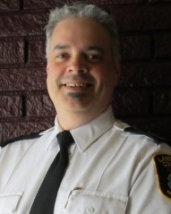
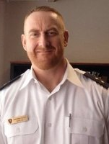
CITIG’s Board
Assistant Deputy Chief Michael Sullivan, Ret. Ottawa Fire Services, CITIG Chair
Chief Jeff Brooks, Manager, Emergency Medical Services Department, County of Lambton, CITIG Vice Chair
Inspector Brendan Dodd, Windsor Police Service, CITIG Secretary
Association Advisors
John-Paul Cody-Cox, Executive Director, CAFC
Kelly Nash, Executive Director, Paramedic Chiefs of Canada
Mike Webb, E-Comm 9-1-1 and CACP ICT Committee

Slide 5
CITIG in Numbers (as of February 27, 2015)
3 years of operation as a NFP by Associations
141,011 page views of www.citig.ca since March 2010
53,288 recipients of CITIG eNews Messages
5604 in person participants at the series of forums and workshops held across Canada
1912 members registered on www.citig.ca
8 annual workshops , 6 annual Vendor Outreach Forums , 27 Regional Forums and 4 Canada-US Cross Border Interoperable Communications Workshops
Works in partnership with 3 chiefs associations and many other stakeholders
1 goal: Improve public safety interoperability in Canada!

Slide 6
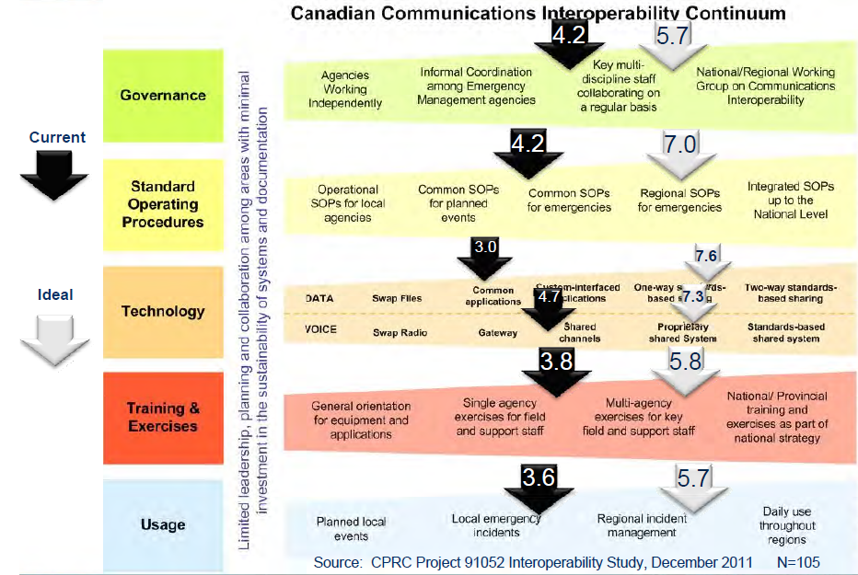
Interoperability Levels with Responders

Slide 7
CITIG Priorities for 2015-16
700 MHz Broadband for Mission Critical Public Safety DATA
Key enabler for responders data interoperability
Where is the other 10 MHz of Spectrum?
Encouraging action with the PSBBN
Will not be structured like FirstNet
Canada leading the way on deployables
Meeting with Minister Blaney
See www.action700.ca

Slide 8
CITIG Priorities for 2015-16
Next Generation (NG) 9-1-1
Fundamental change in how agencies get calls
Working with key stakeholders on call for coordinated approach based on standards
Still working to ensure that NG9-1-1 can be coordinated at the national level
F/P/T not keen on having NG9-1-1 added as a new Action Plan under the Communications Interoperability Strategy for Canada
Status Report on www.citig.ca and see www.ng911.ca

Slide 9
CITIG Priorities for 2015-16
Cross-border interoperability
Successful program in 2013 and 2014 thanks to two $100K grants
2013 featured 6 Regional Forums
2014 culminated in CITIG Canada-US Bi-National Cross Border Interoperability Workshop and White Paper in conjunction with NPSTC
Workshop summary and action plans released
White Paper with NPSTC now out!

Slide 10
CITIG Priorities for 2015-16
Location-Based Services
Perhaps area where will see biggest growth
Emerging area tied to trends in consumer services, alerting, tracking, NG9-1-1 and the CPSBBN
Overwhelming amount of information a major concern
Need coordinated standards-based approach
Will form significant part of our future workshop programs

Slide 11
Upcoming Events
CITIG Kincardine and Saugeen Shores Regional Forum April 21 and 22 in Port Elgin, ON
CITIG’s Ninth Canadian Public Safety Interoperability Workshop, Nov. 29 to Dec. 2 in TBA
See www.citig.ca for more information

Slide 12
Thank You!
Eric Torunski
Executive Director
Canadian Interoperability Technology Interest Group (CITIG)
Ottawa, Ontario, Canada
eric.torunski@citig.ca
Tel: 613.730.5544 / Fax: 613.730.5545
www.citig.ca
Follow us on Twitter @CITIG_Canada

