Slide 1
Implementing Critical Information Sharing
NPSTC Meeting - Wednesday, May 6, 2015
Charles Werner, NISC Chair Chief, Charlottesville, VA Fire Department

Slide 2
Fire, EMS, Law Enforcement
Emergency Management
gov’t
industry
ngos
academia
Private Industry & Critical Infrastructure
IT &
Comms
Homeland Security
Military
GIS & Information Sharing

Slide 3
whole of
community
national
regional
state
local & tribal
public &
private sectors
Notes:
Who are we? All sectors
NISC is unique:
ground-up philosophy – local, pushing out to national; everything builds on local
Not just government – private sector as well

Slide 4
Data & Information
Practitioners & Policymakers
Best Practices & Lessons Learned
Tools & Applications
access
Notes:
What are we about?
In a word: ACCESS
Data – maximizing access to nationally relevant data through partnerships and use of a suite of tools – ArcGIS Online being one
Practitioners and Policymakers – peer-to-peer capacity building; influence on national policy and activities (IMIS-SC as an example)
Best Practices and Lessons Learned – Leveraging efforts and outcomes (CAPSTONE-14 AGOL report as an example of technical focus; data creation and publication guidance as a result of CAPSTONE-14 as an operational example)
Tools and Applications – Working on best ways to maximize access to technologies, code, etc.
t

Slide 5
Working Groups
Advisory Councils
Needs &
Requirements
Implementation Projects Program
CAUSE III
CAPSTONE-14
Emerging Gaps & Best Practices
technical &
operational
workflows
governance, SOPs, training, technology, & usage
approach
White House Incident Management Information Sharing Committee
Virtual USA®
NISC Information Sharing Environment
Policy & Grant Guidance
Situational Awareness
Capabilities
standardized technical & operational workflows
information access,
sharing &
management
Notes:
How will we do it?

Slide 6
Needs &
Requirements
Emerging Gaps & Best Practices
approach
Policy & Grant Guidance
Situational Awareness
Capabilities
Notes:
How will we do it?

Slide 7
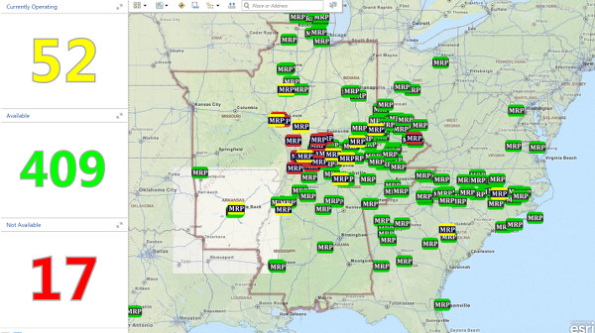
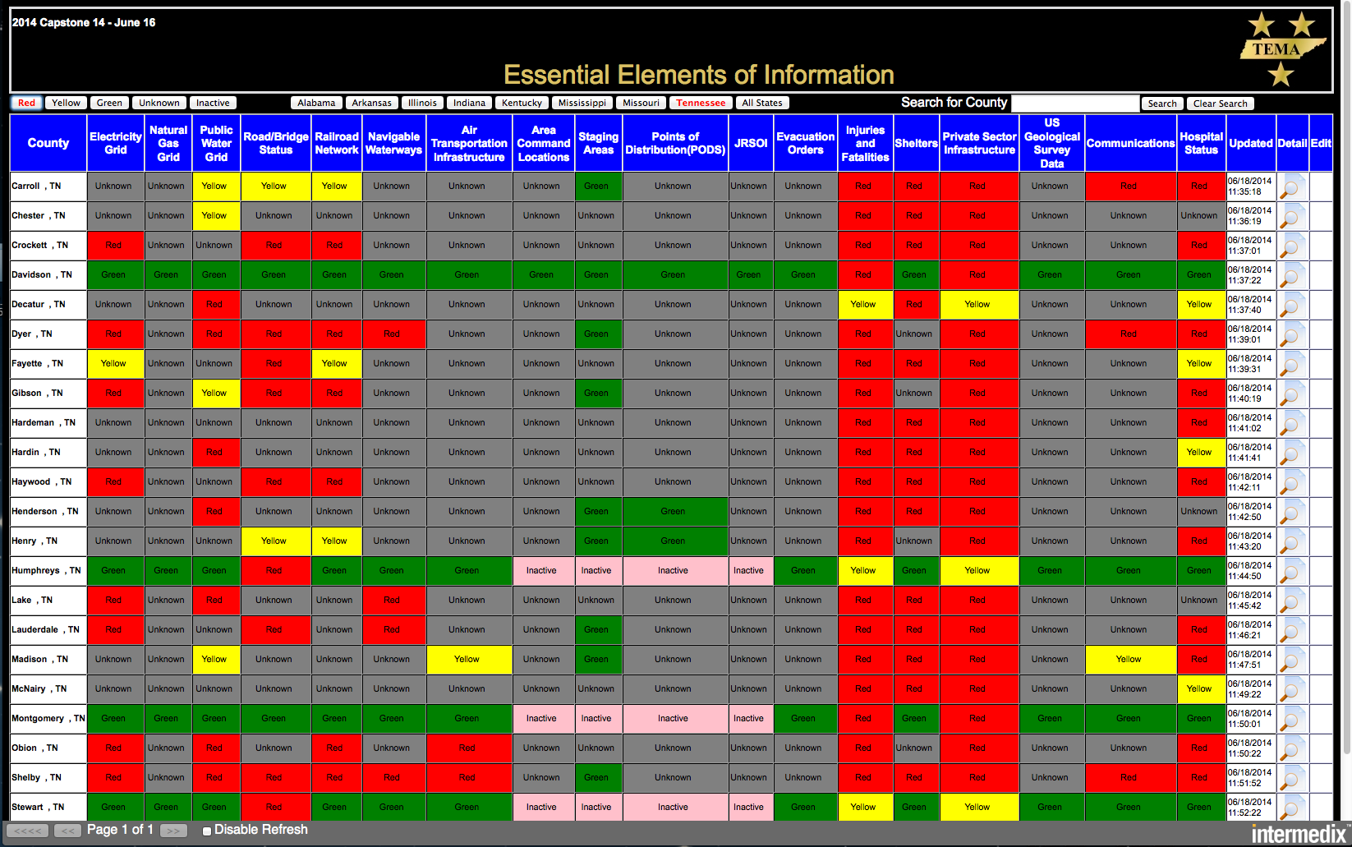
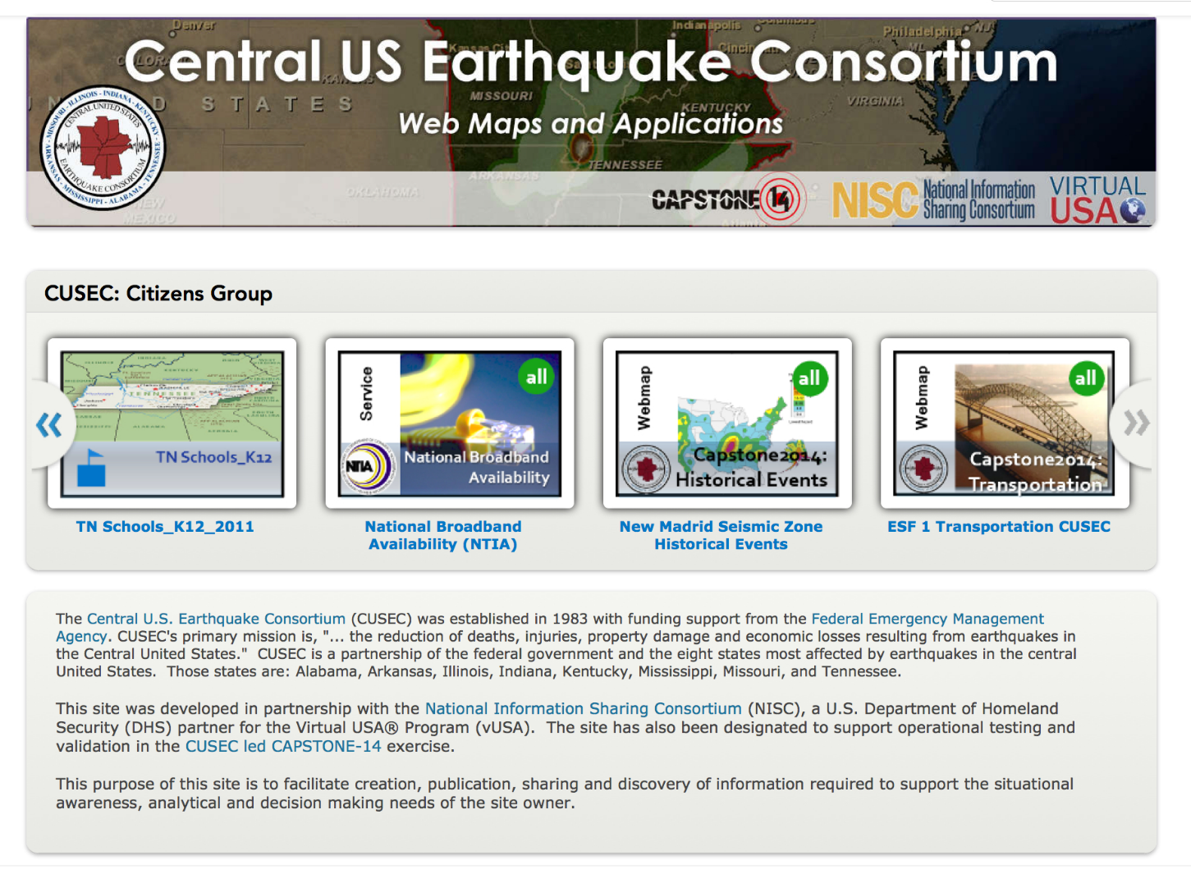
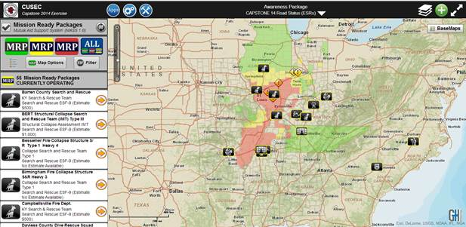
CAPSTONE-14 AAR: Technology
Notes:
Technology-related lessons from CAPSTONE-14 (which Director Monken will present on later this afternoon) will play a pivotal part in the evolution of the Virtual USA Program and the technologies that are able to uphold its principles
NISC will develop an after action report that will evaluate the use of ArcGIS Online as a backbone for data creation, publishing, and sharing during the exercise. Additionally, NISC will examine use of other technologies including Esri’s Collector App, Briefing Book, and an information management system called VIISE SitRoom

Slide 8
NISC
Sharing
Model
(vision)
Cloud-based & on-premise data libraries, servers, systems of record
Usage & Decision-making
Direct, but controlled, access to data libraries
Nationally-relevant data organized in packages = meaningful, immediate & repeated use & sharing
Creation & Publication
Notes:
Watch – see what’s been done; what this could look like on a national level

Slide 9
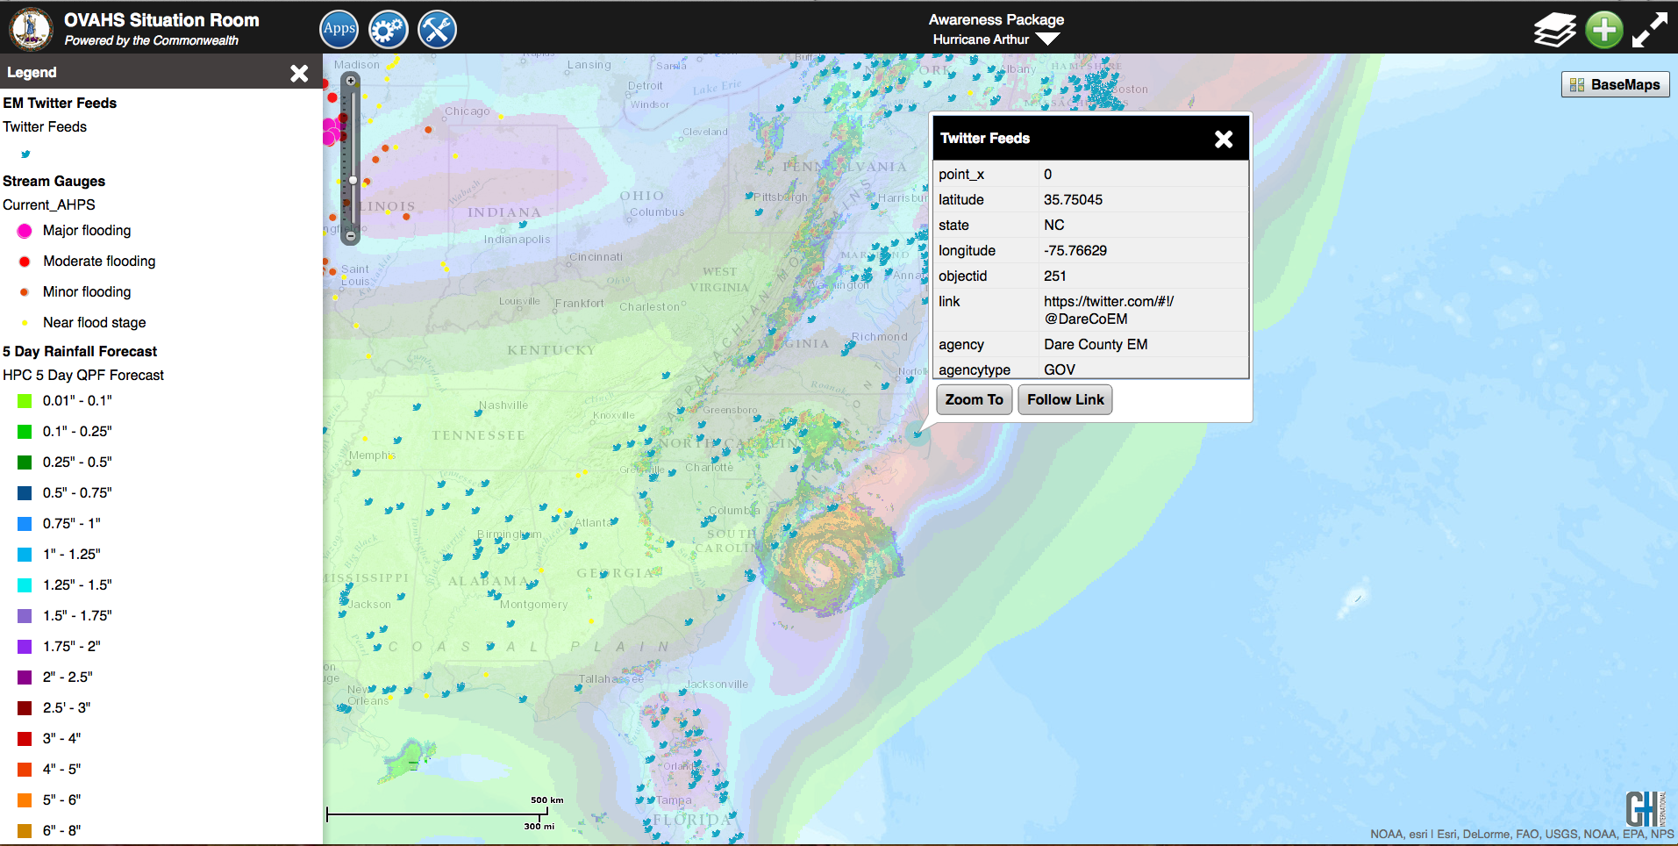
Hurricane Arthur and authoritative EM Twitter feeds
Secondary is the non rain event status, by combining 5 Day Rainfall forecast we see that
Hurricane Arthur’s heaviest rain is all out over the open waters of the Atlantic.

Slide 10
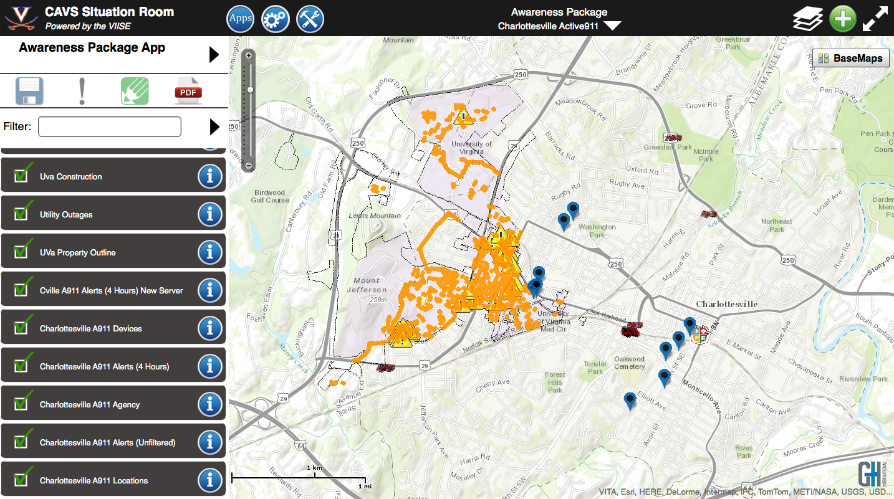
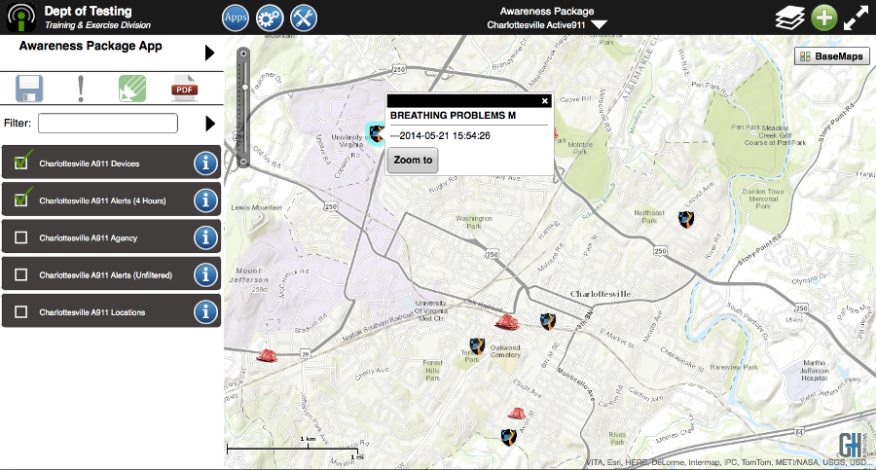
Active 911 with AVL Feed for Charlottesville Fire Department

Slide 11
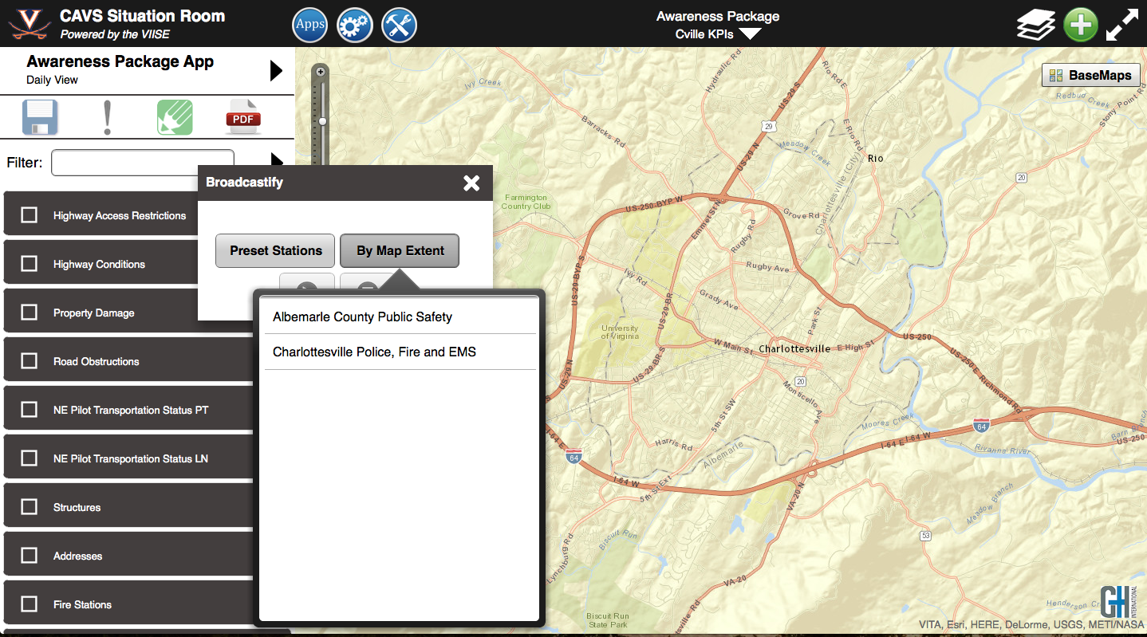
Broadcastify with AVL Feed for Charlottesville Fire Department

Slide 12
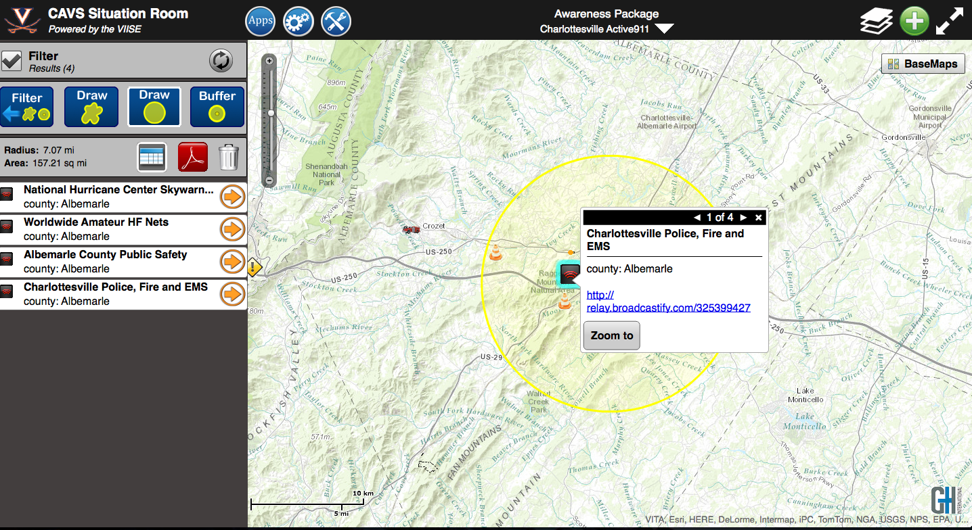
Broadcastify with AVL Feed for Charlottesville Fire Department

Slide 13
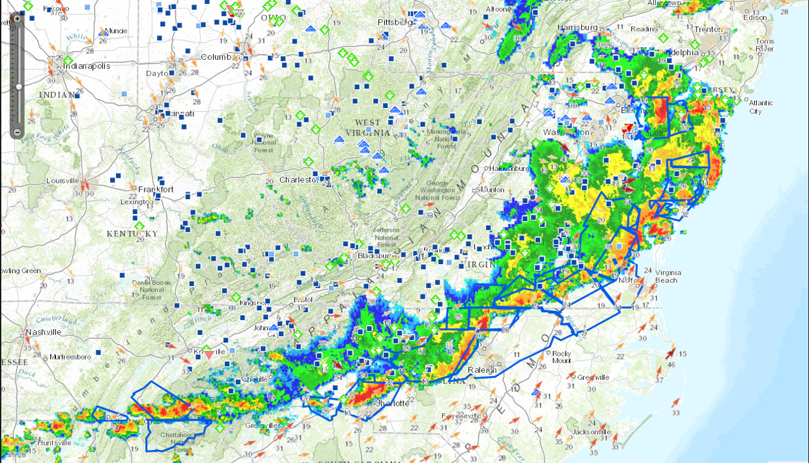
Extreme weather in Virginia:

Slide 14
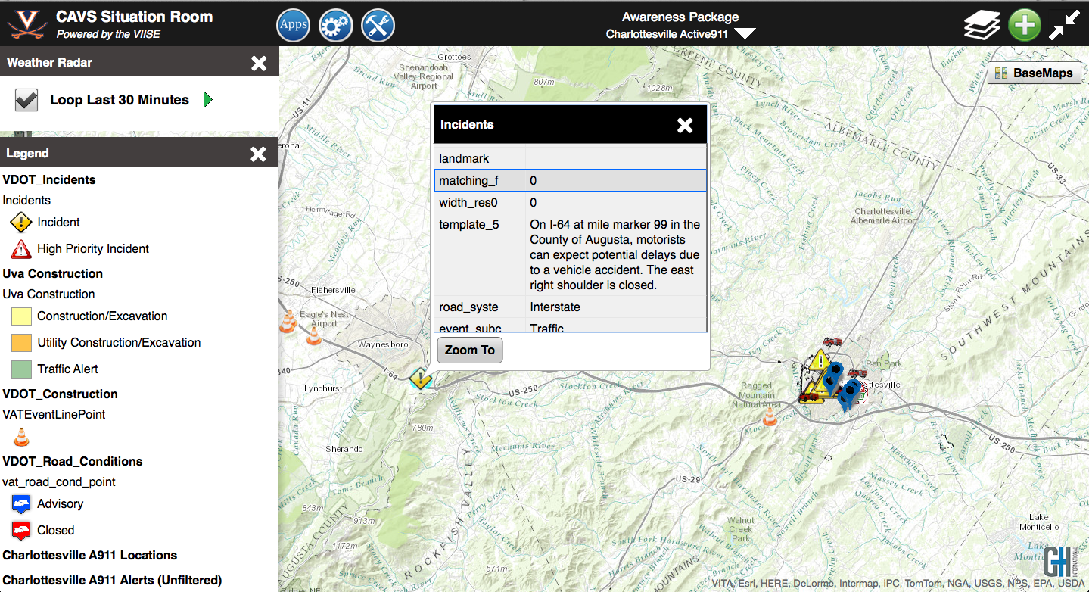
Regional Situational Awareness

Slide 15
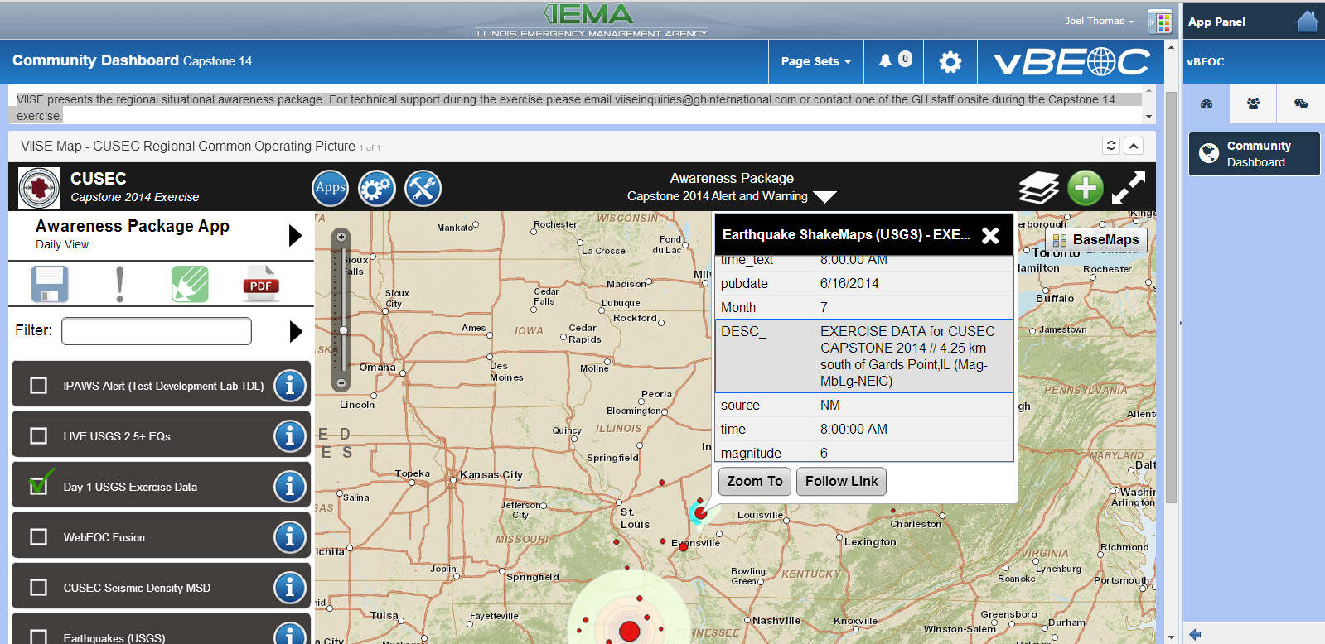
Private Sector Symposium

Slide 16
Incident Management Information Sharing Sub-committee
Use Case / Requirements Development
& Landscape Review
Interoperability & Information Sharing: data/models, SOPs, technology
Future State: continuum, maturity model, transition, sustainment
POLICY RECOMMENDATIONS
GRANT GUIDANCE
NATIONAL BASELINE
Communications &
Partner Engagement
Notes:
From practitioners to policy – a cycle for ensuring that national efforts and industry developments are DRIVEN by practitioner needs.

Slide 17
join us on behalf of your organization or company
Questions?
Request the NISC Memorandum of Agreement
www.nisconsortium.org
info@nisconsortium.org

