Slide 1
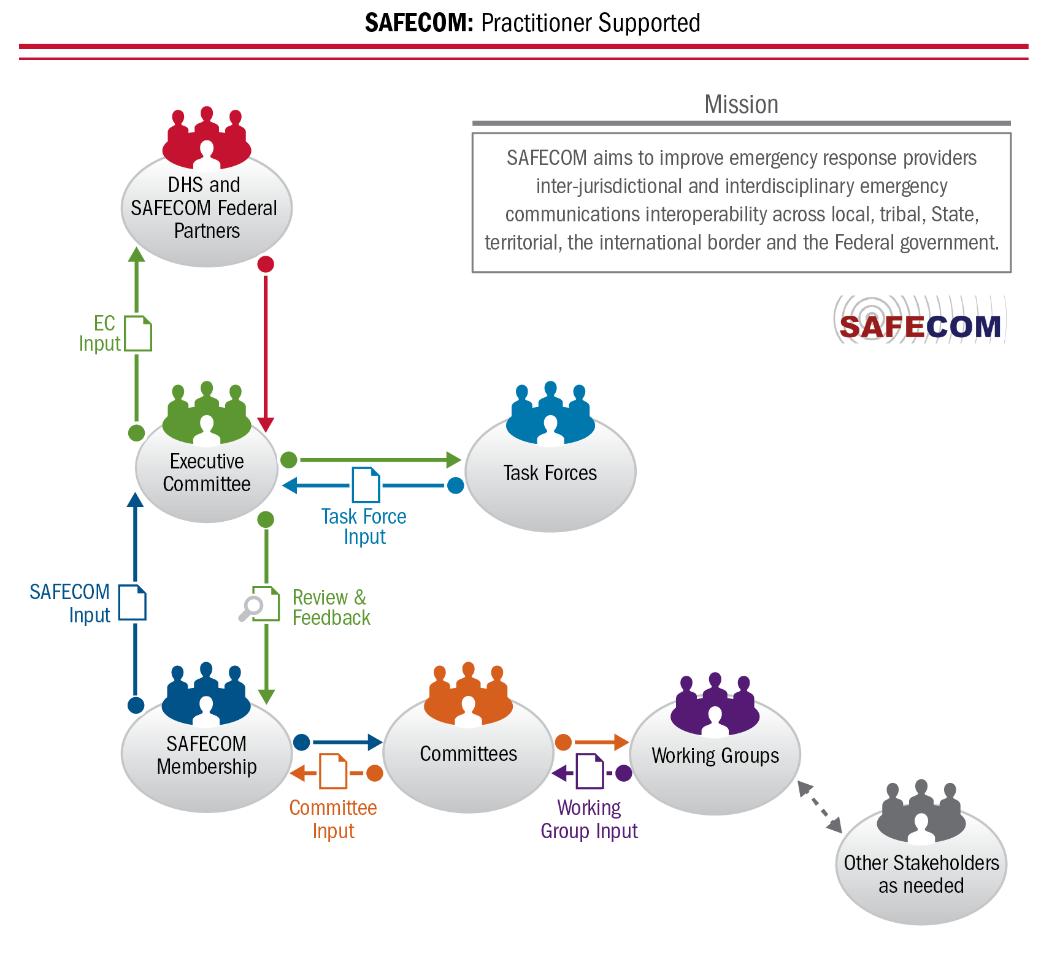
SAFECOM Structure Update
Notes:
A description SAFECOM’s reorganization (i.e., transition to a committee structure)

