Slide 1
Office of Emergency Communications (OEC) Update
National Public Safety Telecommunications Council In-Person Meeting
March 25, 2016
Chris Essid
Deputy Director
OEC
Notes:
Good morning - it is a pleasure to be here in person with you today.
I would like to share some recent OEC accomplishments and upcoming initiatives.

Slide 2
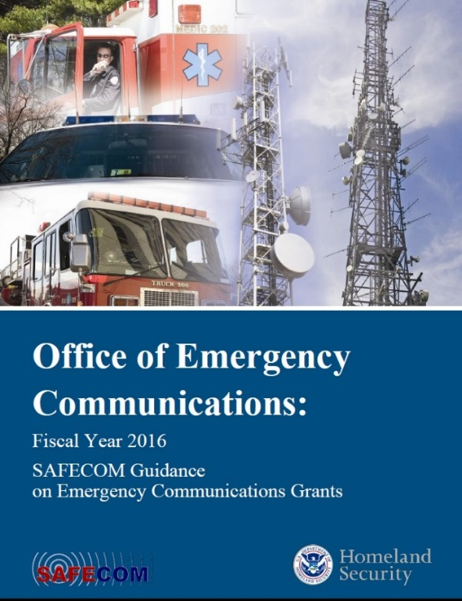
New Releases: Grant Guidance and LMR Trio
Fiscal Year 2016 SAFECOM Guidance on Emergency Communications Grants
Land Mobile Radio (LMR) Trio:
LMR 101, Part I: Educating Decision Makers on LMR Technologies
LMR for Decision Makers, Part II: Educating Decision Makers on LMR Technology Issues
LMR for Project Managers, Part III:
A Project 25 Primer for Project
Managers and Acquisition Managers
Notes:
2
In February we released the FY16 SAFECOM Guidance on Emergency Communications Grants. It aligns with the 2014 NECP, emphasizing the need to enhance the policies, governance structures, plans, and protocols that enable communications and information sharing in today’s environment.
This year’s funding priorities remain consistent with previous SAFECOM Guidance releases, balancing the need to invest in the preparation for new communications technologies, while also sustaining current LMR systems.
17 of the 21 federal grant programs that allow spending on emergency communications reference the SAFECOM Guidance. In fact, it is recognized as the primary guidance on emergency communications grants by the White House and the Office of Management and Budget.
In FY16, we expect this Guidance to impact $1.62B of grant funding where communications investments are allowable costs. In the last 10 years, DHS Preparedness Grants alone have reported spending $2.9B on communications.
The SAFECOM/NCSWIC Funding and Sustainment Committee also just released three papers on LMR technologies – known as the “LMR Trio”.
Stakeholders are increasingly challenged to justify the need for continued investment in LMR with the creation of the NPSBN. We released the LMR Trio to provide stakeholders with a resource to educate decision-makers and funders on the importance of LMR technologies, and the need to sustain and support LMR during the development of the NPSBN.

Slide 3
National Governors Association Policy Academy
2016 Focus: Enhancing Emergency Communications Interoperability
Five competitively selected states will develop and present recommendations and plan of action to the governor
2006 NGA Policy Academy on interoperability resulted in the creation of:
DHS OEC
2008 NECP
SWICs, SIGBs, & SCIPs
IECGP funding
Notes:
Next, I’d like to tell you about the National Governor’s Association Policy Academy, a partnership between NGA and OEC.
Through this Policy Academy, we aim to assist states in addressing challenges to interoperability that exist today with LMR, 9-1-1, Broadband, Alerts & Warnings, and Social Media.
NGA has selected five states to participate. The goal is to enhance governance capacities at the state level for public safety emergency communications interoperability in the new communications ecosystem.
By the end of the Academy, participating states will be prepared to present recommendations and a plan of action to their governor. The results of this effort will hopefully become best practices for the Nation.
As a reminder, the last time NGA Policy Academy on interoperability was 10 years ago and it resulted in the creation of OEC and the NECP; identification of the need for SWICs, SCIPs, and SIGBs; and prioritized the importance of IECGP funding.
We are very excited to see what comes out of this round of the NGA Policy Academy.

Slide 4
Interoperability Priorities for 2016 and Beyond
Strengthening SCIPs, SWICs, SIGBs, & COMU programs
Measuring response-level communications in urban areas
Exploring new audiences for OEC technical assistance
Enhancing federal interoperability
Investigating feasibility of interoperability grant funding
Notes:
OEC has ambitious priorities for 2016 to improve response-level communications.
We are doubling down our support for State-level governance, especially focusing on SWICs, SCIPs, SIGBs, and Communications Unit programs.
OEC is launching an initiative to measure response-level communications in major urban areas.
This effort will be similar to the UASI assessment for NECP Goal 1 in 2010, except in 2010 we focused on LMR. In this new effort, we will be looking at the full range of emergency communications technologies used by the locality today.
We hope to launch the pilot this summer and expect to support this initiative in dozens of major cities over the next few years. Right now we are working to gather stakeholder feedback on the approach and identify pilot locations and events.
OEC currently offers technical assistance to all 56 states and territories. In 2016, we will begin consulting with stakeholders to explore the possibility of developing technical assistance offerings for tribal nations and federal responders.
In support of improving Federal response interoperability OEC has partnered with the DHS Joint Wireless Program Management Office and FEMA to develop and provide interoperability training to DHS radio users.
The training is ongoing now with the goal of reaching all DHS response entities in 2016, and then bringing the training to other federal agencies in 2017 and beyond.
Lastly, we’ve heard from stakeholders how important grant funding has been to their interoperability programs and the challenges they have faced since the end of IECGP and other grants. We are working with DHS leadership to explore the feasibility of providing another dedicated interoperability grant.
We will continue to keep you updated on our progress with these initiatives.

Slide 5
Notes:
Once again, it was a pleasure to see you all here today and throughout the week at IWCE. Thank you for inviting me to speak with you.
As always, OEC is a strong supporter of NPSTC – we greatly value the partnership we have with the public safety community.
At this time, I’m happy to answer any questions you may have.

