Slide 1
Radio Programming and Management (PAM) Tool
APCO Presentation Theater
Tuesday August 5, 2014
Tom Sorley, Co-Chair
Dan Robinson, Co-Chair
Scott Glazer
Notes:
1

Slide 2
Background
May 2011, NPSTC Radio Programming Compatibility Requirements (Radio PCR) working group created to address programming incompatibility between various manufacturers radios for interoperability
2012/2013, Excel tool designed to address import/export from vendor software
August 2013, Demonstration using the spreadsheet at the 79th Annual APCO Conference
December 2013, Public Safety Testing and Feedback
March 2014, NPSTC’s Governing Board approved the Programming and Management (PAM) Tool

Slide 3
PAM Tool Development Participants
Radio Programming Compatibility Requirements (Radio PCR) Working Group under NPSTC Technology Committee
Co-Chairs (New) Dan Robinson and Tom Sorley
User group participants Kenneth Link, Paul Roberts, Scott Glazer, Pam Montanari and many others
Manufacturers Motorola Solutions, Harris, EF Johnson, Icom America, Kenwood, Thales, RELM Wireless, Midland and Tait Communication

Slide 4
PAM Tool Overview
Tool designed to assist with programming different vendor radio in an interoperability situation
User must already have vendor programming software
User must know how to use vendor software
Provides basic level of interoperability
Can be pre-populated prior to event
Provides an inter-vendor glossary of terms
Does not provide authorization for trunking programming, only provides information
Fixed data set allows vendor to develop import/export function into vendor software while allowing user interface to grow
Will be version release controlled

Slide 5
PAM Tool
Current Release Features
Release A3 available, www.npstc.org/radioPCR.org
Raw Data Set, defined and locked to allow vendors to start development and implementation of export/import capabilities in vendor programming software
Integrated NIFOG Information
Manual data entry
Support for Conventional Analog, Conventional P25 and P25 Trunking (Phase 1 and 2)
Multi-vendor cross reference of terms for programming fields

Slide 6
PAM Tool Overview
The intent of this tool is for coordination of data to facilitate an interoperable event.
This tool is not designed to be used for large scale system fleet programming.

Slide 7
Tabs
Easy to navigate color coded tabs
Work in left to right order
Divided in to Mandatory Optional

Slide 8
Tab Layout
Instructions
Manufacturer Conversion Sheet
Conventional
Mandatory
Optional
Trunked
System Mandatory
Talkgroup Mandatory
System Optional
Talkgroup Optional
Channel Plan
Manufacturer Tabs
NIFOG

Slide 9
Instructions

Slide 11
Conventional
2 Tabs – Mandatory / Optional
Mandatory Tab
Channel name show READ ONLY from Optional Tab
3 Sections. Can be expanded for future support (DMR/NXDN etc)
All Conventional
Analog
P25
Optional Tab
Channel Name
Analog – MDC1200 ID
P25 - Encryption

Slide 12
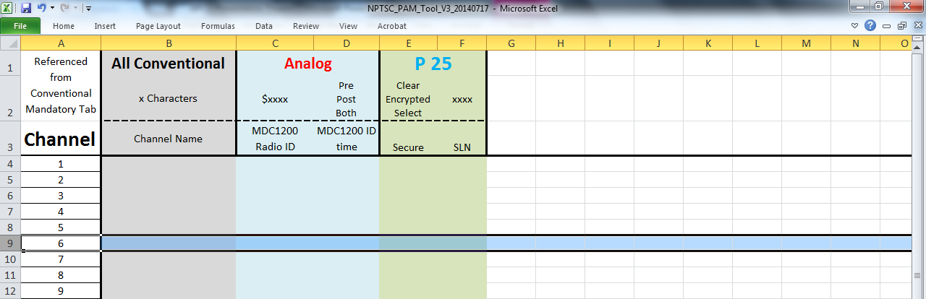
Conventional

Slide 13
Trunked System
2 Tabs – Mandatory / Optional
Mandatory Tab
System Name READ ONLY from Optional Tab
System General – Basic system information
IDEN – Channel ID Plan – 16 IDEN
Control Channels – Can be extended as far as needed
Optional Tab
System Name
Full Spectrum Control Channel Scan
Composite Control Channel
System Encryption SLN

Slide 14
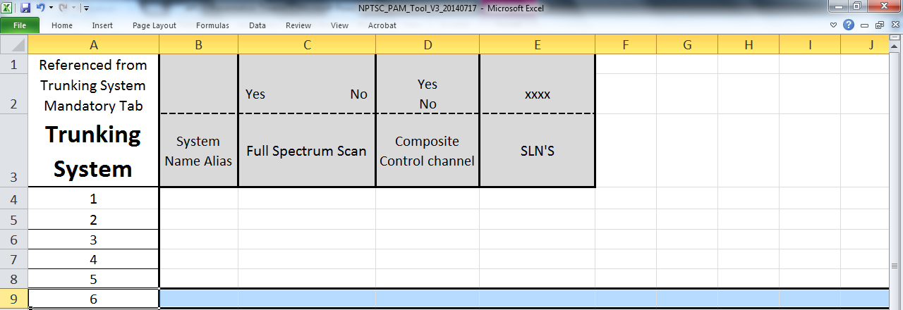
Trunked System

Slide 15
Trunked Talkgroup
2 Tabs – Mandatory / Optional
Mandatory Tab
Talkgroup Name READ ONLY from Optional Tab
System ID – This refers to the System ID number on the Trunked System Mandatory Tab
Talkgroup ID in Hex
Optional Tab
Talkgroup Name
Encryption
PTT Type
Failsoft
Announcement Talkgroup
ISSI

Slide 16
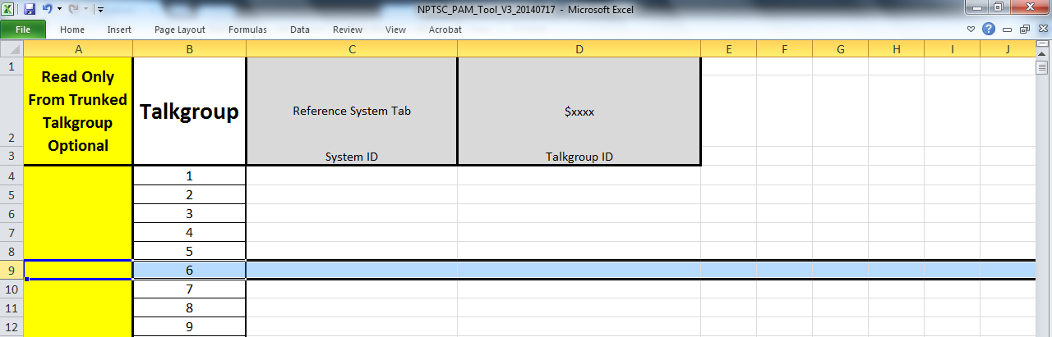
Trunked Talkgroup

Slide 17
Channel Plan
Supports unlimited number of Zones
Supports unlimited number of Channels per Zone
Zone name is OPTIONAL
Channel/Talkgroup assignment is done as follows:
Channel 1 = C1
Talkgroup 4 = T4
Channels and Talkgroups are referenced from Conventional Mandatory and Talkgroup Mandatory Tabs
Optional Channel/Talkgroup Names are defined on the Channel Optional and Talkgroup Optional Tabs

Slide 18
Channel Plan

Slide 20
NIFOG
Entire NIFOG included
Ready to cut and paste to Conventional Tabs
Set up in 3 Sections
1 – Reference information. Do not cut and paste.
2 – Channel Name. Cut and paste on Conventional Optional Tab
3 – Channel Details. Cut and paste on Conventional Mandatory Tab

Slide 21
NIFOG Tabs
NIFOG – All channels from NIFOG in same order as NIFOG
NIFOG in Order – All channels in naming order
VHF – Divided in to VHF Lo and VHF
VHF Broken in to ALL and by type
UHF – Divided in to ALL and by type
700/800 – Divided in to ALL, 700 and 800
Weather
Marine

Slide 22
NIFOG

Slide 23
Future Additions
View Single Conventional Channel
View Single Trunked System
View Single Trunked Talkgroup
Drop down to select items
IC205/217 Integration
Drop down selection and population from PAM Tool

Slide 24
View Single Conventional Channel

Slide 25
View Single Trunked System

Slide 26
View Single Trunked Talkgroup

Slide 27
IC205 Integration

Slide 28
Future Initiatives
Automation of single channel/system/talk group tab
Automation of IC205/IC217 integration
Integration into All Hazards COML/COMT curriculum and training
Integration in to CASM
Event / Response Demos
Conference Demos
User Training
Distribution – Responder Toolkit
Tool for download on Public Safety Tools website

Slide 29
Continued Development
Users
Download the Tool and start to use it.
Pre-populate the Tool for local and regional area similar to IC217
Regularly use tool in response and with programming software
Manufacturers
Continue development and implementation of export/import to the Tool from vendor software.
Volunteer for the Committee
http://npstc.org/joinToParticipate.jsp

Slide 30
Question or Comments?

