Slide 1
TCCA update
Phil Kidner CEO TCCA

Slide 2
TCCA update
I am very pleased to be attending this meeting
The TCCA values highly its relationship with NPSTC

Slide 3
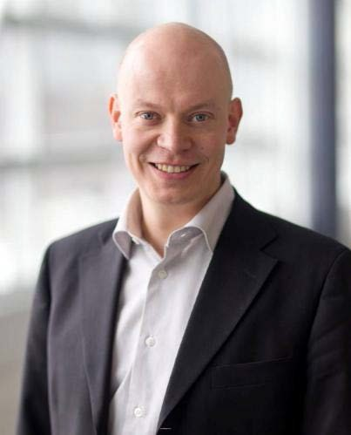
TCCA input
The TCCA broadband work is led by its working group CCBG
The group has elected a new Chairman Tero Pesonen who replaces Tony Gray. Tero represents the Finland Security network
Emmanuelle Villebrun from the French MOI continues as Vice Chair
Several other European PS operators are also participating in 3GPP

Slide 4
Spectrum
The TCCA continues to work for harmonised spectrum in Europe and elsewhere

Slide 5
3GPP SA 6
TCCA welcomes the creation of SA 6 and looks forward to supporting the work done there.
Should it be extended to include all critical communications functionality ?

Slide 6
Thank you for listening

