Slide 1
Texas Interoperability &
Broadband Update

Slide 2
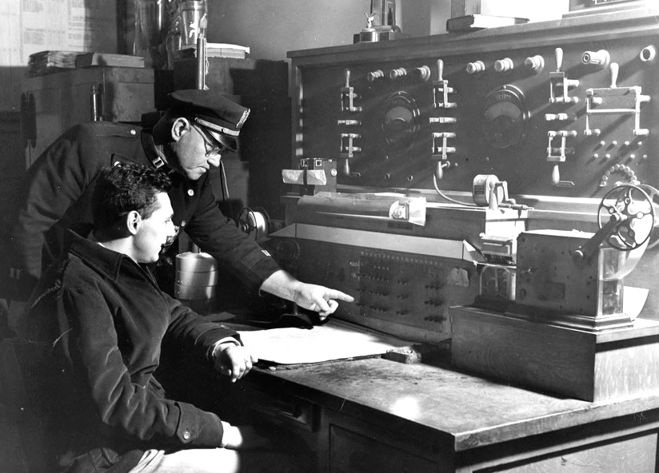
How Far Have We Come?

Slide 3
How Far Have We Come?
1930s: The Radio Patch (encoder)
Texas state and local dispatchers used radio encoders to patch disparate radio channels for emergency response incidents.

Slide 4
How Far Have We Come?
1950s-1960s
Inter-city Channels
The amazing transistor
Hand-held radios
First portable based public safety radio systems

Slide 5
2001: Texas Interagency Radio Work Group (IRWG)
Formally established by the 77th Legislature

Slide 6
2001: Texas Interagency Radio Work Group (IRWG) Radio MOU
Texas Department of Public Safety
Texas Department of Transportation
Texas Parks & Wildlife
Texas Alcoholic Beverage Commission
Texas Department of Criminal Justice
Texas Forest Service
Texas Youth Commission
Texas Sheriff’s Association

Slide 7
2003: Texas Immediate Interoperability Plan
Expanded the initial MOU signed by State Agencies and the Sheriffs Association.

Slide 8
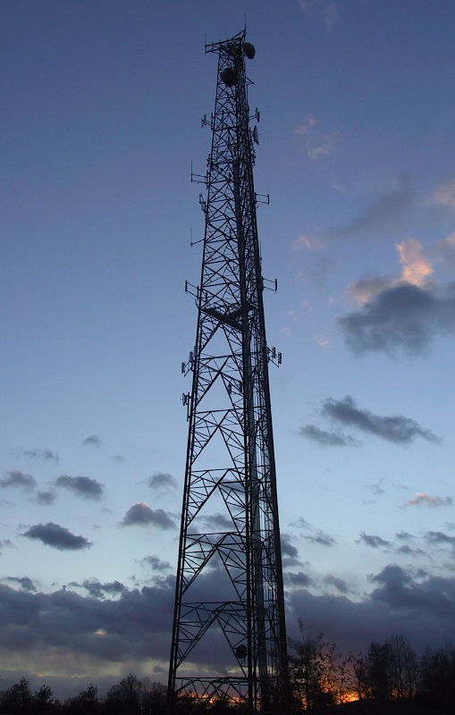
April 2005 - March 2014: Texas Interoperability Channel Plans (TICP)
2005 Original TICP
2014 Current Texas Statewide Interoperability Channel Plan (TSICP)
Incorporated a mobile satellite talkgroup and a statewide radio ID plan

Slide 9
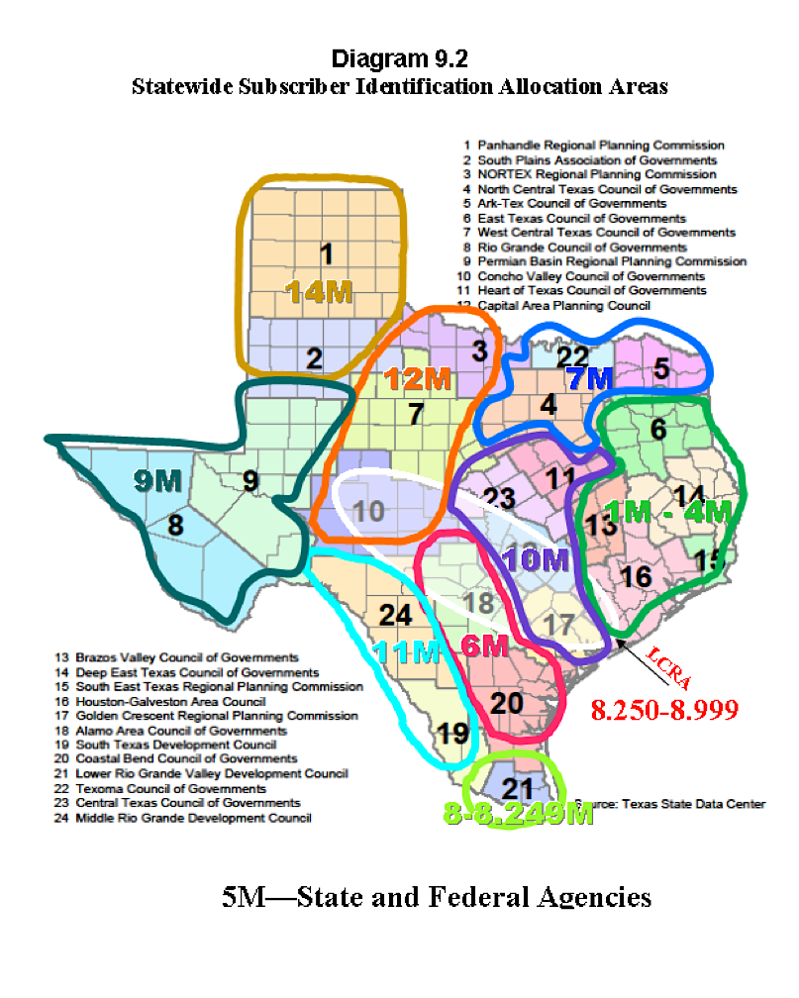

Slide 10
2006 – 2007
Texas Radio Coalition
Tasked by Texas Homeland Security Director Steve McCraw with updating the Texas Statewide Interoperability Plan to meet the current DHS Statewide Planning criteria.
Voluntary association of Texas government entities and affected agencies and organizations

Slide 11
2007: DHS released the Statewide Interoperability Planning Guidebook
Gov. Rick Perry:
“Radio interoperability in Texas is particularly challenging because of its size and geographic diversity…I am proud to report to you today that Texas has achieved level four radio interoperability…”

Slide 12
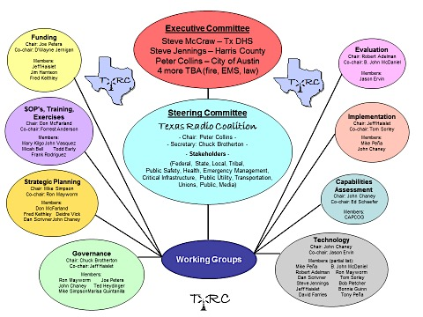
2007: SCIP Governance Structure established

Slide 13
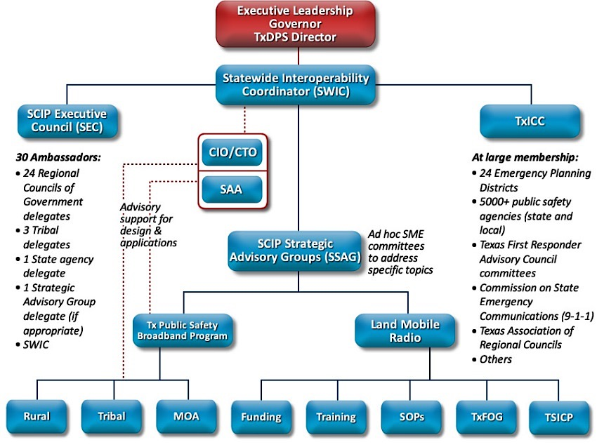
2014: SCIP Governance Structure

Slide 14
2007: Developed and instituted Annual Regional Focus Group Interoperable Survey template
Each region required to hold annual interoperable communications focus group sessions
SCIP initiatives based on input from the Focus Group sessions
The template is updated and reformatted each year with DHS operational and reporting priorities

Slide 15
2008:
National Emergency Communications Plan (NECP) Released

Slide 16
Goal 2:
By 2011, 75 percent of non-UASI jurisdictions are able to demonstrate response-level emergency communications within one hour for routine events involving multiple jurisdictions and agencies.

Slide 17
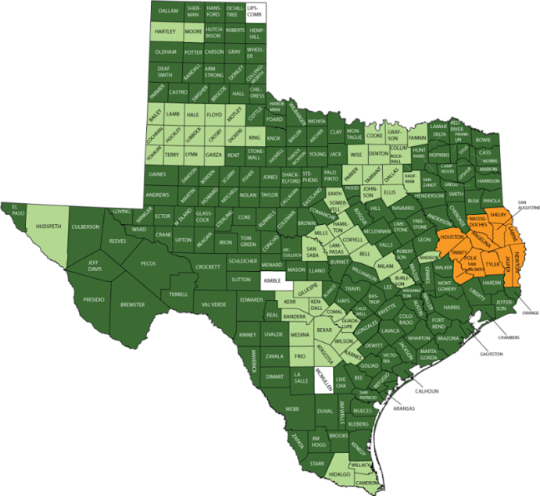
2011: NECP Goal 2 Demonstrations
Advanced
Established
Early
Not Demonstrated
Not Available
Reporting Counties:
251 of 254
Performance: 98.8%

Slide 18
2009: Communications Coordination Group Established

Slide 19
2009: Communications Coordination Group Established
Formalized under the State of Texas Legislative and Executive Mandates effective September 1, 2009
Provide an integrated state approach for ensuring communications coordination both prior to and immediately following a tactical and/or infrastructure event, including man-made and nature-produced emergencies

Slide 20
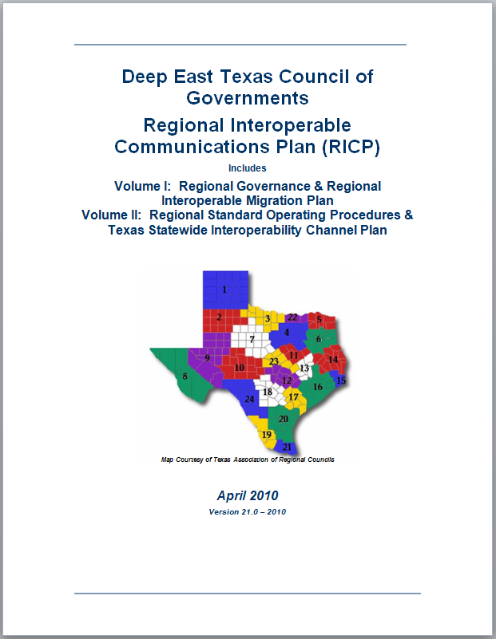
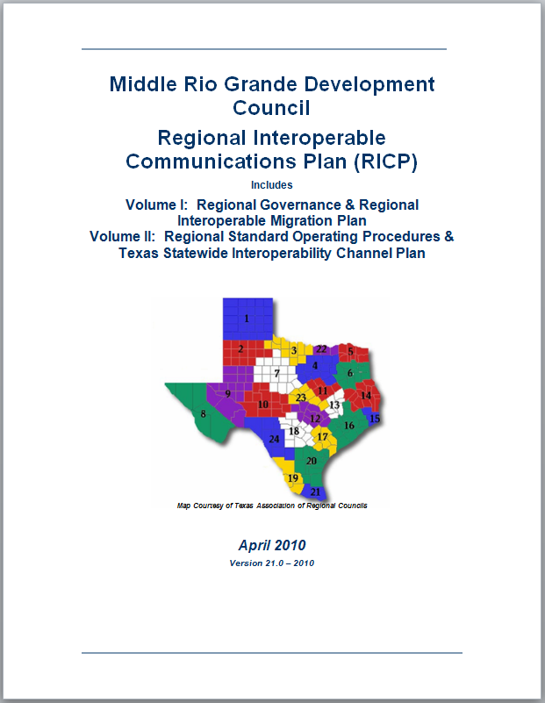
2009: RICP Round One
In 2009, Texas began Round 1 of the Regional Interoperable Communications Plans which included Regional Governance and Standard Operating Procedures

Slide 21
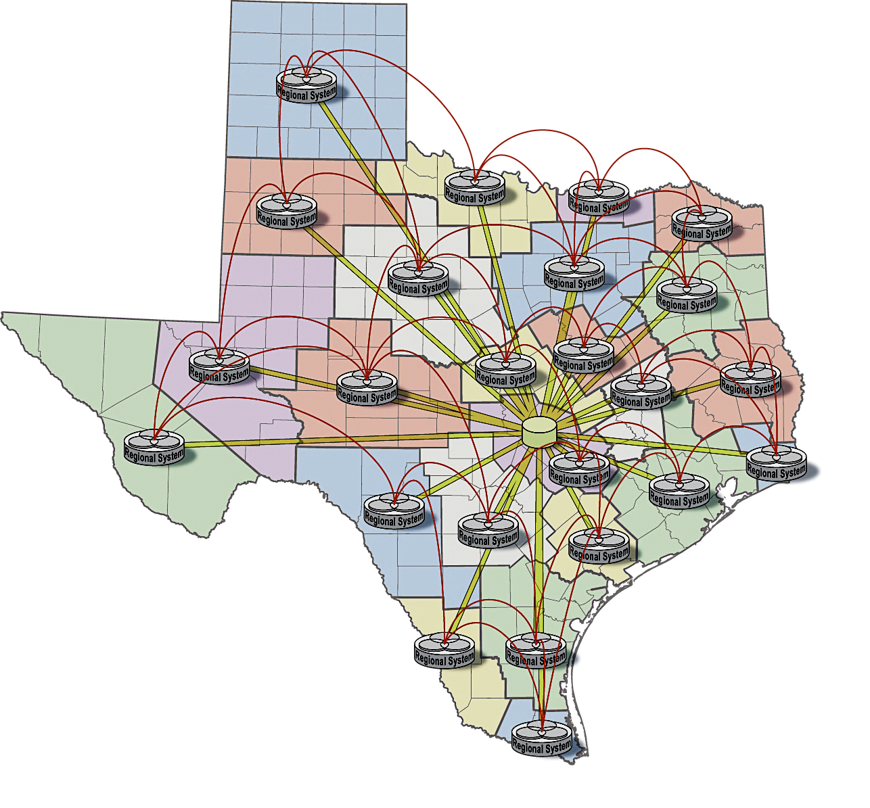
Texas Regional Land Mobile Voice Radio System of Systems

Slide 22
2011: Developed and Hosted Region 6 States Broadband Summit

Slide 23
2010: First Annual Texas Legislative Report

Slide 24
Legislative Report provides status of Interoperability in Texas.
Funding Gaps
Breakdown by recipient of federal grant funds distributed by the state
Interoperability level by county (based on Texas Interoperability Maturity Model)
Regional Focus Group reports serve as a vital resource for information

Slide 25
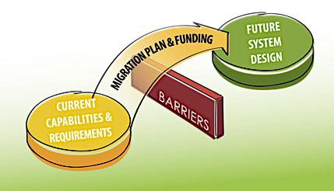
2011: RICP Round 2
Round 2 of the RICPs included Future System Design and Migration/Budget/Gap analysis and planning.
RICP Round 2 Strategy Gameboard

Slide 26
2012: Texas Kicks-off Texas Public Safety Broadband Program Education & Outreach
Why Public Safety Broadband?
Why Now?

Slide 27
St. Peter’s Square: The Vatican
Pope Benedict Debut
Pope Francis Debut
Now, data and devices are everywhere!
Only 9 Years Ago It Was Still Uncommon…
Look! A Flip Phone!

Slide 28
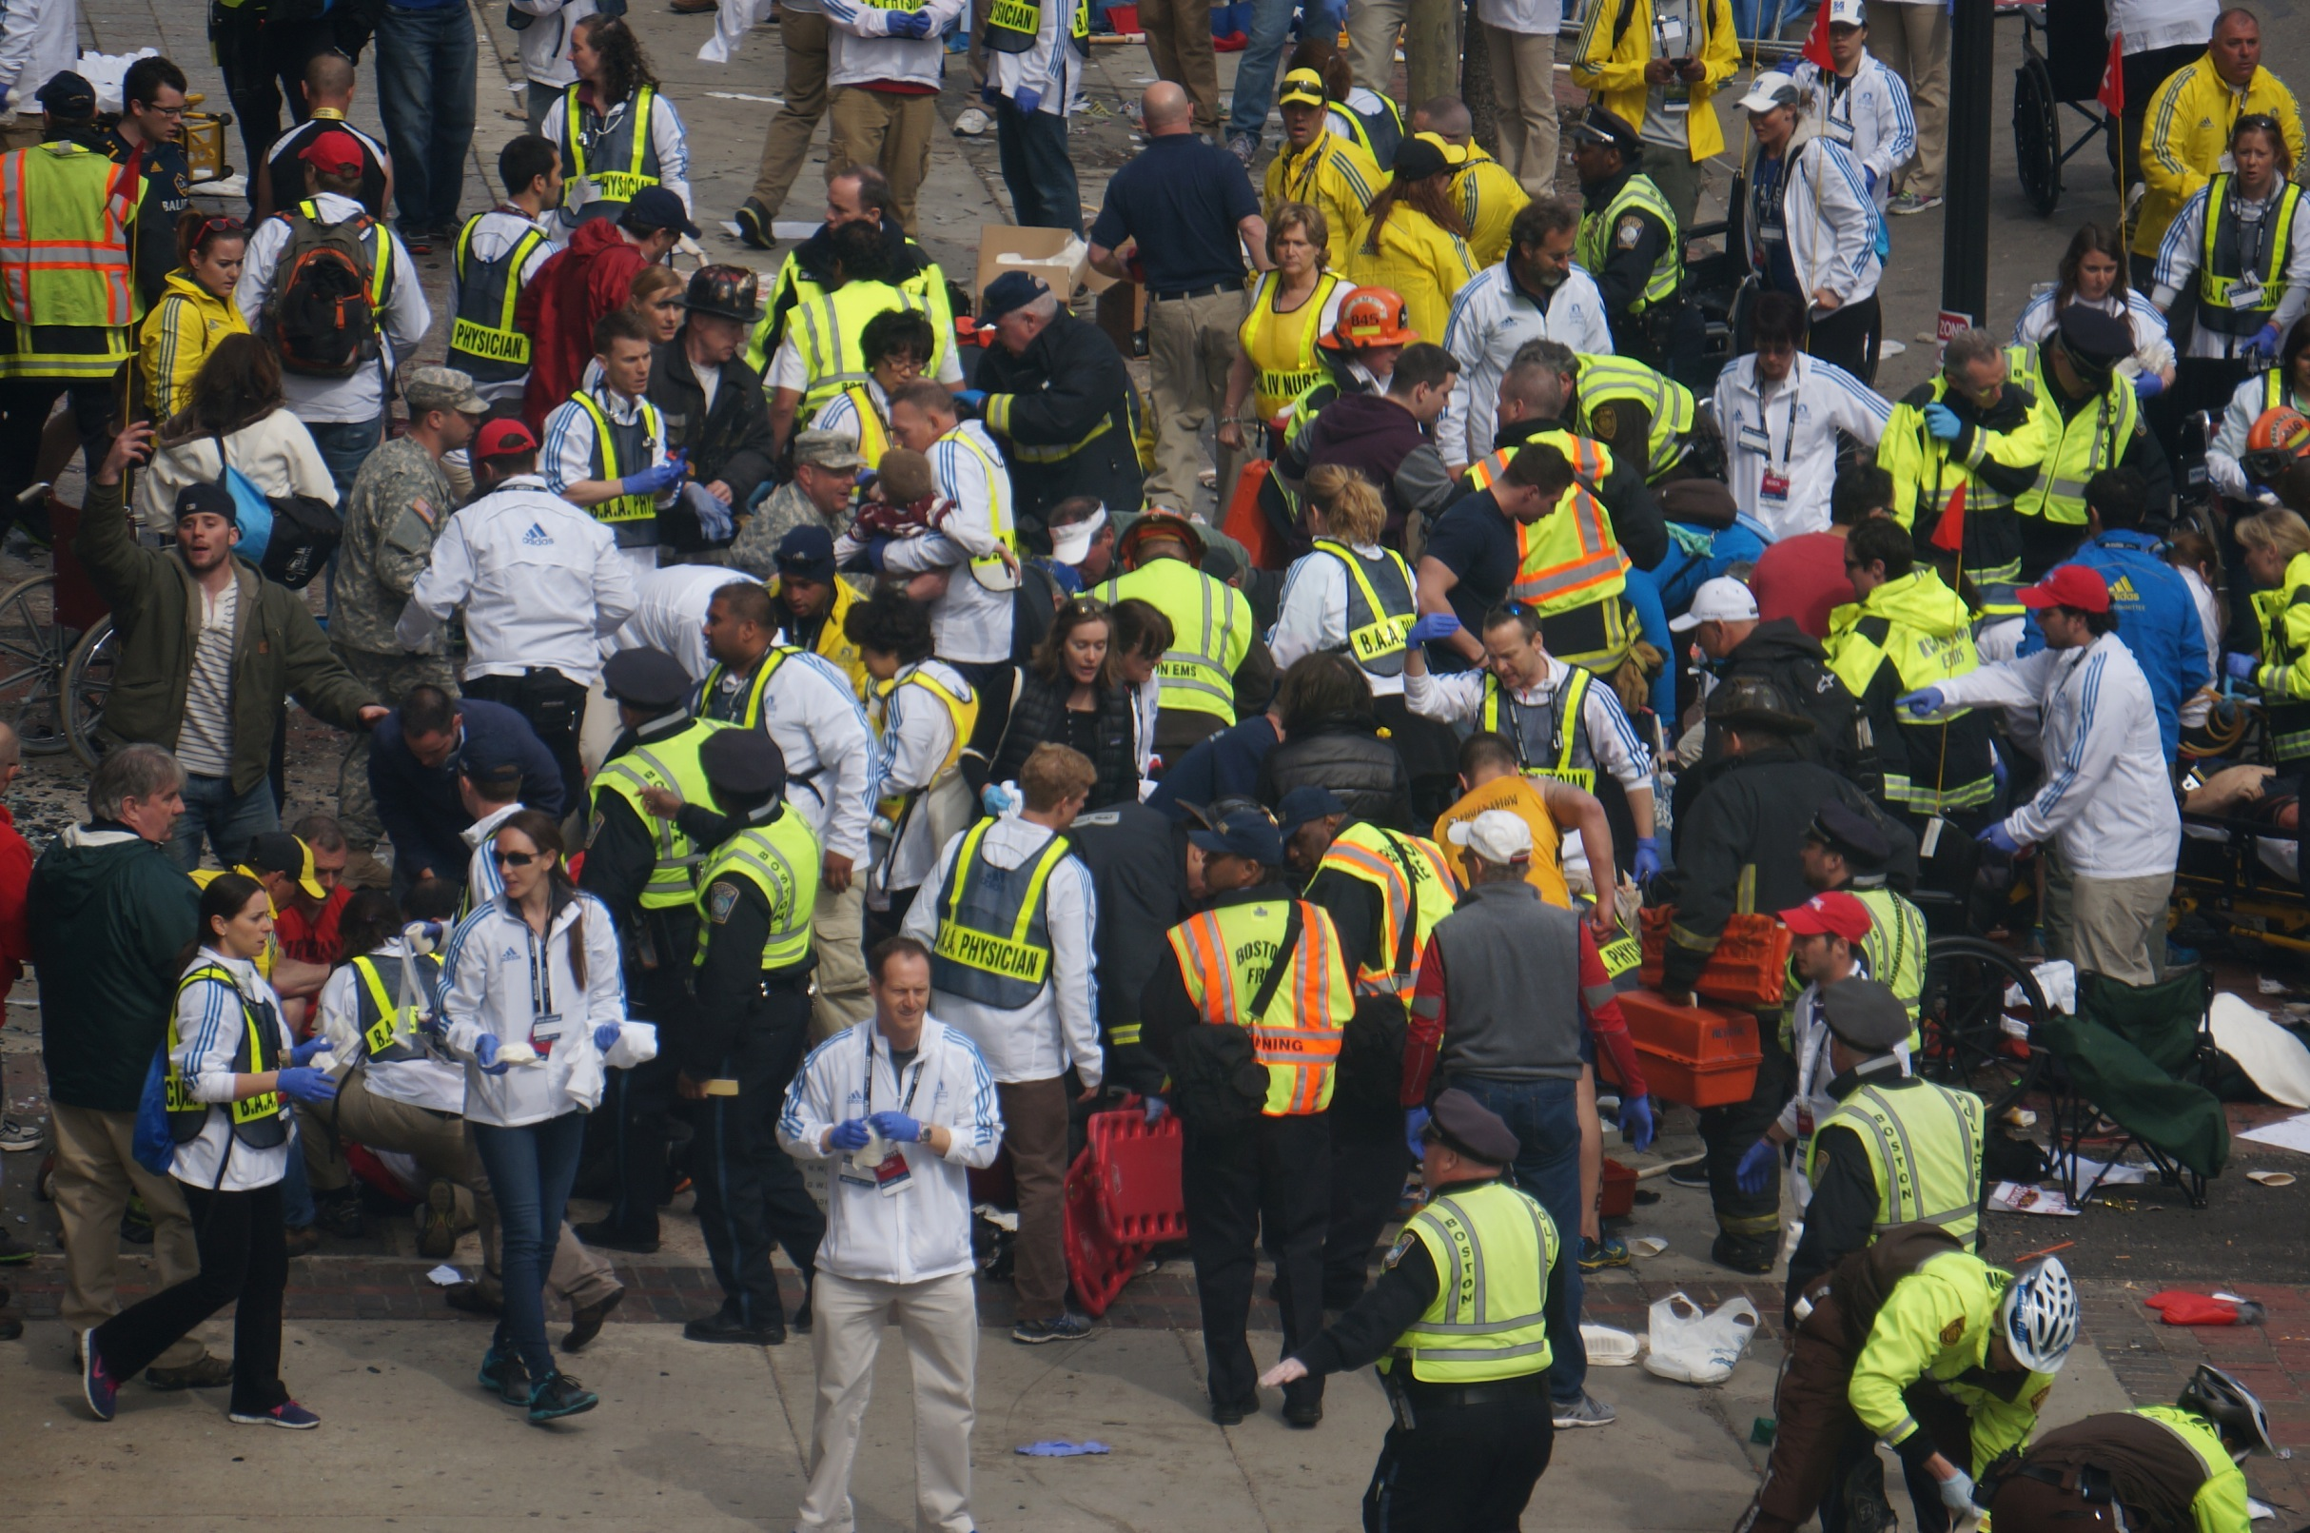
Except here…

Slide 29
Public Safety LTE Timeline
2001
2008

Slide 30
2009
2010

Slide 31
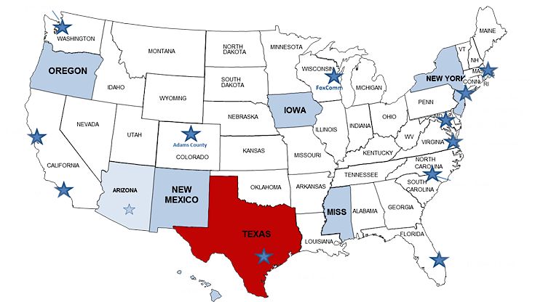
2011
2012

Slide 32
2013

Slide 33
State and Local Implementation Grant Program (SLIGP)
Targeted Outreach & Education
SMLA
2014

Slide 34
BIG-Net
Broadband Interoperable Gateway Network

Slide 35
Harris County Big-Net
First fully licensed public safety LTE system in the nation
LTE core in College Station
Pilot operation in Baytown, Texas and Port of Houston
93 approved sites

Slide 36
Spectrum Management Lease Agreement
Spectrum for Harris County build-out
Deployable eNodeB
Site at College Station/Disaster City

Slide 37
Spectrum Management Lease Agreement
SMLA signed in August 2014
Includes 5 Key Learning Conditions:
Core Transition
Data Analytics
Special Events
Extended Mode
Training

Slide 38
2013-2014
Presented to over 5,000 stakeholders and interested parties through workshops, conference presentations and local meetings.

Slide 39
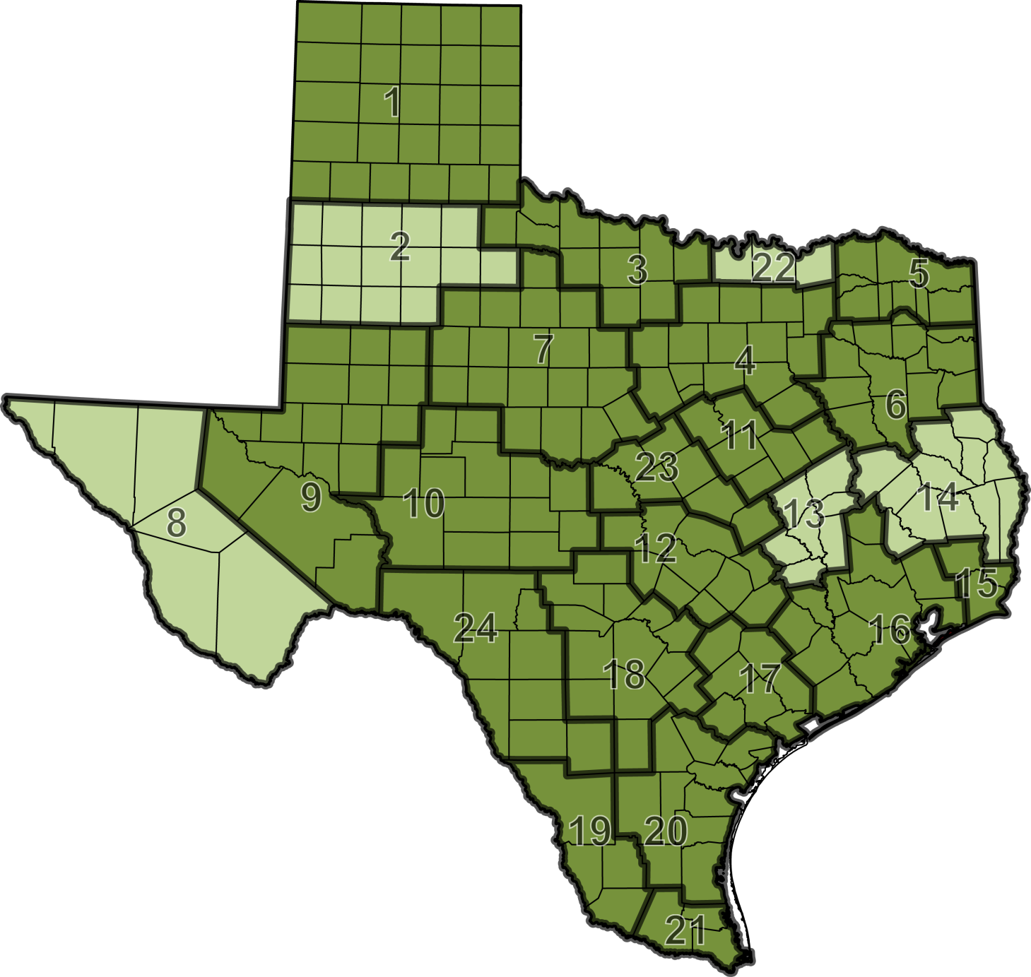
Regional Kickoff Meetings
Completed
Scheduled

Slide 40
8th Annual Strategic Planning Conference
November 4, 2014
Bastrop, TX

Slide 41
Texas Interoperability &
Broadband Update

