Slide 1
Full NPSTC Meeting
Conference Call
September 15, 2015 | 1:00 pm – 3:00 pm ET
Call In: (510) 227-1018 | Conference ID: 192 7086#
Webinar Access: https://join.me/npstcsupport1
Press *6 to mute your phone.

Slide 2
Welcome and Opening
Paul Patrick, 2nd Vice Chair

Slide 3
Welcome and Opening
Call to Order
Roll Call
All Attendees including Governing Board Representatives please send an email to attend@npstc.org with your name and organization in the body of the email, please enter “Full NPSTC Meeting 9.15” in the subject line
Please email questions during the meeting to support@npstc.org.
Please mute your phone by pressing *6 and do not press your “hold” button. Press *5 to raise your hand to speak.

Slide 4
Thank you! And Welcome!
AASHTO – Bill Brownlow retired; welcome Paul Gilbert
APCO - Brent Lee is stepping down as alternate; welcome Martha Carter
FCCA - Paul Leary is stepping down; Lloyd Mitchell will be new primary
NASF - Both representatives: TBA
NASTD - Terry LaValley stepping down; welcome Jacqueline Miller
NCSWIC - George Molnar is stepping down; new alternate: TBA

Slide 5
Federal Partners Update
Department of Homeland Security (DHS), Office for Interoperability and Compatibility – Cuong Luu, Federal Program Manager
Public Safety Communications Research (PSCR) – Dereck Orr, Division Chief

Slide 6
FirstNet National Public Safety Broadband Network (PSBN) Development
Public Safety Advisory Committee (PSAC) – Harlin McEwen, Chairman
FirstNet – Kevin McGinnis, FirstNet Public Safety Board Member

Slide 7
Technology and Broadband Discussion
Tom Sorley, Chair | Andy Thiessen, Vice Chair

Slide 8
Technology and Broadband Discussion
Current Working Group Status – Tom Sorley
Priority and Quality of Service (PQoS) Working Group, completed
Local Control Working Group, mostly complete
Broadband Deployable Systems, in progress

Slide 9
Technology and Broadband Discussion
Work Underway by Other Organizations
Applications: Association of Public Safety Communication Officials (APCO)
ANSI Standard on Site Hardening: APCO
Review of Commercial Cellular, Voice Over LTE, and Push to Talk: APCO
Cyber Security: APCO, National Institute of Standards (NIST), FirstNet
Mobile Communications Unit, Identity Credential and Access Management: Public Safety Advisory Council (PSAC)
Location Based Services, Analytics Research, Land Mobile Radio (LMR) to Long-term Evolution (LTE) transition: PSCR
Next-Generation 911 /FirstNet: APCO, National Emergency Number Association (NENA)

Slide 10
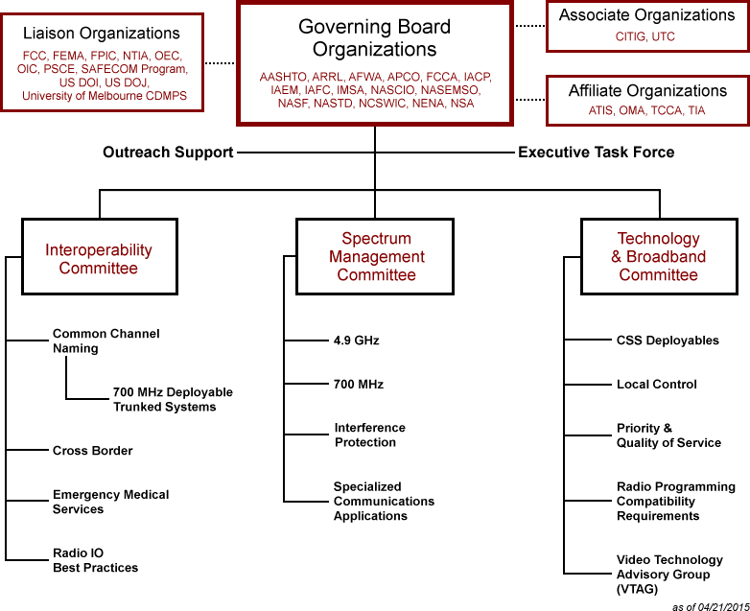
NPSTC Organization Chart

Slide 11
Technology and Broadband Discussion
Future NPSTC Broadband Work – Tom Sorley
Broadband Emerging Technologies
LMR to LTE Migration
3rd Generation Partnership Project (3GPP) Mission Critical Voice Standards
Devices/User Equipment
Sensors and Analytics
Broadband Messaging and Telephony
Public Safety Video
FirstNet Rural Implementation Issues
FirstNet Status Web Page

Slide 12
Technology and Broadband Discussion
Future Technology Work – Tom Sorley
Drones and Unmanned Aerial Vehicles (UAV’s)
Need working group to consolidate law enforcement, fire and Emergency Medical Services (EMS) issues and monitor evolving standards and rules on government, commercial and hobby use
Action Requested
Vote to Create:
Broadband Emerging Technologies Working Group
LMR to LTE Migration Working Group
Drone/UAV Working Group
Vote to close:
PQoS Working Group

Slide 13
Interoperability Discussion
John Lenihan, Chair | Don Root, Vice Chair

Slide 14
Interoperability Discussion
Emergency Medical Services – Paul Patrick, Chair
EMS Telemedicine Report Update
Continue to compile comments and feedback
Assessing survey results by urban, suburban and rural; as well as by EMS, hospital and physician
Final Report anticipated to Governing Board for approval 4th quarter 2015
Presentation by Dr. David Persee, Houston Fire Department (HFD) on video consultation between HFD paramedics and physicians
EMS Working Group is working with Video Technology Advisory Group (VTAG) on video issues

Slide 15
Interoperability Discussion
700 MHz Deployable Trunked Systems Task Force – David Buchanan, Chair
Joint project between NPSTC and National Regional Planning Council (NRPC)
Goal to provide process for outside resources to easily access deployable trunked radio systems
Final report ready for review and approval

Slide 16
Interoperability Discussion
700 MHz Deployable Trunked Systems Task Force
Report Highlights
Six channels authorized for nationwide interoperable trunked radio systems
RPC’s must modify their Regional Plan by October 30th to incorporate channels (no requirement to do so; T-Band areas have unique priorities)
Management of System ID via assignment of a Manufacturing ID and selection of a common Wide Area Communications Network (WACN) ID; coordinated by NRPC

Slide 17
Interoperability Discussion
700 MHz Deployable Trunked Systems Task Force
Report Highlights, continued
Management of Subscriber IDs via set of recommended best practices to allow intra-WACN roaming and use of dedicated range of subscriber IDs
Program administered via NRPC using CAPRAD to request, assign and track assigned System IDs
Talk Group Zones, Talk Group Names, and Talk Group ID’s identified to promote interoperability
Final issues
Assignment of Network Access Code, $293
Talkgroup Zone and Naming Convention
Questions/Comments from the Governing Board

Slide 18
Interoperability Discussion
700 MHz Deployable Trunked Systems Task Force
Requested Action
Approval of “700 MHz Deployable Trunked Solutions, A Report by NPSTC and the NRPC,” with recommended edits
Authorize NPSTC Executive Director to send letter to Telecommunications Industry Association (TIA) supporting NRPC request to be issued appropriate ID’s to manage process
Authorize NSPTC Chair or Executive Director to submit final report to FCC for information, following NRPC approval

Slide 19
Federal Partners Update (continued)
Federal Communications Commission (FCC) – David Furth, Bureau Chief, Public Safety Homeland Security Bureau (PSHSB)

Slide 20
Spectrum Discussion
David Buchanan, Chair | Stu Overby, Vice Chair

Slide 21
Spectrum Management Discussion
4.9 National Plan Update – David Buchanan
NPSTC and APCO worked together on 4.9 GHz Report
FCC indicated that action is likely before end of 2015 and another Notice of Proposed Rulemaking (NPRM) will likely be issued

Slide 22
Filings Completed YTD in 2015
Date Filed | Topic | Type of Filing
Sept. 9 | LightSquared | Ex parte re test plan to FCC
Sept. 9 | 800 MHz band Interstitials | Comments on LMCC protocol
July 29 | LightSquared/GPS | Letter to FCC
July 27 | FirstNet Draft RFP | Comments to FirstNet
July 13 | Interference Dispute Resolution | Comments to FCC
July 6 | Rules on Public Safety Airborne Use | Ex Parte to FCC
July 1 | AT&T Waiver Request - Kansas | Comments to FCC
July 1 | RF Interference from Lighting | Letter/Report to FCC
June 19 | Waiver Request-Ultra Wideband | Comments to FCC
June 4 | FirstNet Third Notice re PS Definition | Comments to FirstNet

Slide 23
Filings Completed YTD in 2015 (continued)
Date Filed | Topic | Type of Filing
June 8 | 800 MHz band Interstitials | Ex Parte to FCC
May 28 | TIA Recon re P25 CAP at 700 MHz | Ex Parte to FCC
May 11 | 800 MHz Interstitials | Comments to FCC
April 30 | AT&T Waiver Request - Missouri | Comments to FCC
April 28 | FirstNet Second Notice re Opt-Out | Comments to FirstNet
February 17 | Public Safety Interoperability | Letter to GAO
February 23 | TIA Recon re P25 CAP at 700 MHz | Reply Comments to FCC
February 20 | Cellular Service Rules on Power | Reply Comments to FCC
February 13 | 700 MHz Deployable Channels | Letter w/NRPC to FCC
January 5 | Frequency Coordinator Certification | Comments to FCC

Slide 24
New Business and Future Meetings
New business
NPSTC future meetings
Teleconference: 1 – 3 pm, ET, Tuesday, November 10, 2015
Teleconference: 1 – 3 pm, ET, Thursday, January 21, 2016
In-Person Meeting, IWCE: 8:30 am – 5:00 pm, PT, Friday, March 25, 2016

Slide 25
Adjourn | Thank you!
Questions?
support@npstc.org | 1.800.807.4755

