Slide 1
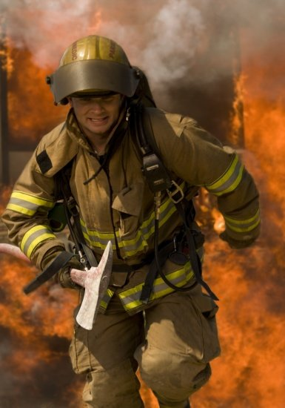
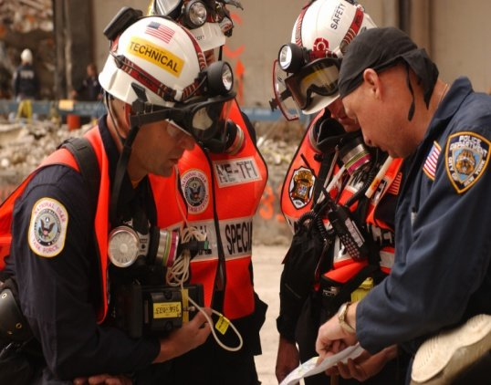
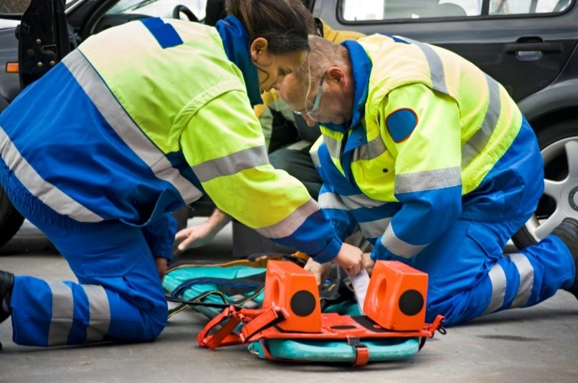
First Responder Broadband Communication Technical Gap Analysis
NPSTC Governing Board Meeting
November 13-14, 2014
Cuong Luu Program Manager Office for Interoperability & Compatibility (OIC) First Responders Group (FRG) Science and Technology Directorate

Slide 2
Meeting Purpose and Outcomes
Purpose: To engage stakeholder community about the OIC broadband communications technical gap analysis task
Outcomes: Shared understanding and prioritization of the technical gaps to inform the path forward

Slide 3
OIC Voice & Data Communications Portfolio Strategic Goals
To provide the science and technology that enables emergency communications and facilitates the seamless exchange of information to save lives and protect property
OIC MISSION:
First Responder Emergency Communications Needs
Goal 1: Bridge Land Mobile Radio (LMR)/Long Term Evolution (LTE)
OIC will be the interoperability and compatibility RDT&E expert that is focused on bridging LMR and broadband networks and improving LMR network efficiency
Goal 2: Advance LTE
OIC will serve as the RDT&E liaison to first responders, enabling broadband networks to meet their requirements
Goal 3: Accelerate Next Generation
OIC will lead RDT&E to discover and develop essential “first responder of the future” communication technologies and capabilities

Slide 4
Technical Gap Analysis: Objectives
Support stakeholder’s requirements
Leverage existing and emerging technologies
Pervasive broadband wireless communications
Wearable technologies
Machine-to-machine and sensor development
Identify and validate existing technical gaps
Prioritize technical gaps and align with the Next Generation First Responder APEX program

Slide 5
Stakeholder References Considered
Project Responder 3 and 4
National Public Safety Telecommunications Council
Mission Critical Requirements, Public Safety Communications, September 2014
Defining Public Safety Grade Systems and Facilities, May 2014
Public Safety Broadband Push-to-Talk over LTE Requirements, July 2013
SAFECOM
Public Safety Communications Evolution, May 2014
Interoperability Planning for Wireless Broadband, November 2011
First Responder Network Authority Public Safety Advisory Committee
Public Safety Communications Research Program Roadmap
Association of Public Safety Communications Officials
Site Hardening, PS Grade Report
NG9-1-1 FirstNet

Slide 6
Technical Gap Analysis Methodology
Review Stakeholder Requirements
Assess Existing OIC Projects and Tasks
Develop Technical Gaps – Preliminary List
Vetting and Prioritizing Preliminary Gaps List
Finalize List of Technical Gaps
Develop Detailed Requirements for Technical Gap
Initiate Project focused on Technical Gap and Develop Knowledge Product
Stakeholder Engagement

Slide 7
Preliminary Gap Prioritization
Preliminary Prioritization (1-highest, 9-lowest) | Technical Gaps
1 | Integrate sensors, Personal Area Network (PAN), M2M into public safety capabilities
2 | Push-to-talk service quality between LTE and LMR
3 | LTE direct mode communications (DMC) for voice and data
4 | 3D Indoor Geo-Location Services
5 | Deployable solutions
6 | Commercial cellular roaming & Broadband Voice/Data/Video for public safety
7 | Data analytics/big data pipes
8 | Broadband enhanced data application and services
9 | Digital TV/Alternative Broadband datacasting

Slide 8
Preliminary OIC Technical Gaps
Preliminary Technical Gaps | Key Considerations
Identify sensors, Personal Area Network (PAN) and machine-to-machine (M2M) and integrate into overall capabilities | Internet-of-Things is ushering an ever-more connected environment of devices, sensors and even automobiles – how will the public safety community benefit from such machine-to-machine communication advancement and promote situational awareness in their daily mission?
Characterize push-to-talk Service Quality between LTE and LMR | Within an interoperable network which connects two different networks, such as LTE and LMR, it is expected to carry real-time mission critical voice traffic to and from each network. However, the LTE network is expected to have a different signaling latency characteristic as compared to the LMR network. How will the difference in the network latency issue impact the operation of the mission critical voice operation?
Enabling Direct Mode Communications (DMC) for LTE devices | Can DMC provide user-to-user communications supporting voice, data or video through the following: 1) prototype availability; 2) increased output transmit power; 3) advanced antenna support (multiple mobile antennas also known as MIMO); 4) mesh networking supporting multi-hop transmission; and 5) enhanced multimedia multicast/broadcast service (eMBMS) to deliver efficient broadcast data

Slide 9
Preliminary OIC Technical Gaps (cont’d)
Preliminary Technical Gaps | Key Considerations
3D indoor Geo-location services | Existing ongoing research with 3D geo-location methodologies will soon provide first responders with indoor location and tracking capabilities. How will this key data be shared with on-scene commanders and field users to gain the ability to know the location of responders and their proximity to risks and hazards in real time?
Deployable LTE base station solutions | Beyond the traditional microwave and satellite links, what additional backhaul means are capable of providing the needed backhaul data connection between the public safety users and the public safety broadband network?
Roaming with commercial cellular broadband – voice/data/video services when there is no public safety LTE coverage | 1) What are the options for commercial broadband roaming and the implications for mobile equipment design and backhaul data link; 2) What can be leveraged from existing cellular carriers’ In-building small cells (e.g., infrastructure sharing); 3) Does the current commercial Push-to-Talk-over-LTE service (e.g., Verizon, AT&T) provide any best practice and lessons learned for the future interoperable public safety broadband network?

Slide 10
Preliminary OIC Technical Gaps (cont’d)
Preliminary Technical Gaps | Key Considerations
Identify data analytics and leverage broadband data pipes to use big data | With a nationwide broadband network (FirstNet), public safety will be provided a wireless broadband capability both to and from the field. How will this data be managed using big data analytics as to not overwhelm the first responder in the field?
Leveraging broadband capabilities to Enhance Data Apps and Interoperability | As the availability of wireless broadband service becomes more pervasive for first responders, the number of new bandwidth-intensive applications will no doubt accelerate to take advantage of the increased capability. Key challenges for first responders will be how many apps can be supported simultaneously at an incident response area, how to prioritize and coordinate broadband resources and, most importantly, to ensure interoperability of communications services.
Analyze Digital TV (DTV) Datacasting/Alternative Broadband and its role in serving public safety communications | When public safety needs to share large data files, such as building blueprints, with first responders in the field, DTV provides a potential supplemental broadband capability using idle broadcast bandwidth– and this capability becomes essential when there is LTE network outage or congestion.

Slide 11
Preliminary Gap Prioritization
Preliminary Prioritization (1-highest, 9-lowest) | Technical Gaps
1 | Integrate sensors, PAN, M2M into public safety capabilities
2 | Push-to-talk service quality between LTE and LMR
3 | LTE DMC for voice and data
4 | 3D Indoor Geo-Location Services
5 | Deployable solutions
6 | Commercial cellular roaming & Broadband Voice/Data/Video for public safety
7 | Data analytics/big data pipes
8 | Broadband enhanced data application and interoperability
9 | Digital TV/Alternative Broadband datacasting
Are these gaps prioritized appropriately?
What additional technical gaps should be considered?
Are any of these priorities dependent on others for success?

Slide 12
Technical Gaps: Your Inputs
Priority (1-highest, 9-lowest) | Technical Gaps (new or adding to an existing gap) | Rationale

