Slide 1
OEC Ecosystem Initiative Technical Assistance Branch Efforts
DHS Office of Emergency Communications
October 31 2014
Notes:
1

Slide 2
OEC TA Branch – FY 2015 Strategic Planning
FY’15 Focus Area / Driver
TA Branch Activity
Communications Ecosystem
9-1-1 / NG9-1-1
Public Safety Interoperability
NECP Release
Governance & Leadership
OEC Coordination
Social Media
Planning and Procedures
Training and Exercises
Operational Coordination
Research and Development
Partnerships
Alerts & Warnings
Regional Coordination
Advanced Technology
Policy & Planning
Comms Portfolio Mgmt
External / Leg Affairs
State-Requested Technical Assistance
National Priority TA Initiatives
Statewide Planning (SCIP) Development & Implementation
Public Safety Tools
Notes:
Developed in 2008, the NECP was designed to serve as an over-arching framework to enhance emergency communications nationwide.
OEC worked closely with key stakeholders at all levels of government and public safety to assess key capabilities and identify gaps.
However, that first plan was developed 6 years ago and was primarily focused on Land Mobile Radio (LMR) networks.
Technology has advanced considerably since then and public safety is becoming more reliant on newer technologies, such as NG 911 and Priority Services.
As a result, under its statutory authority, OEC reviewed the NECP, its goals and its recommendation and began the first comprehensive update of the original plan.

Slide 3
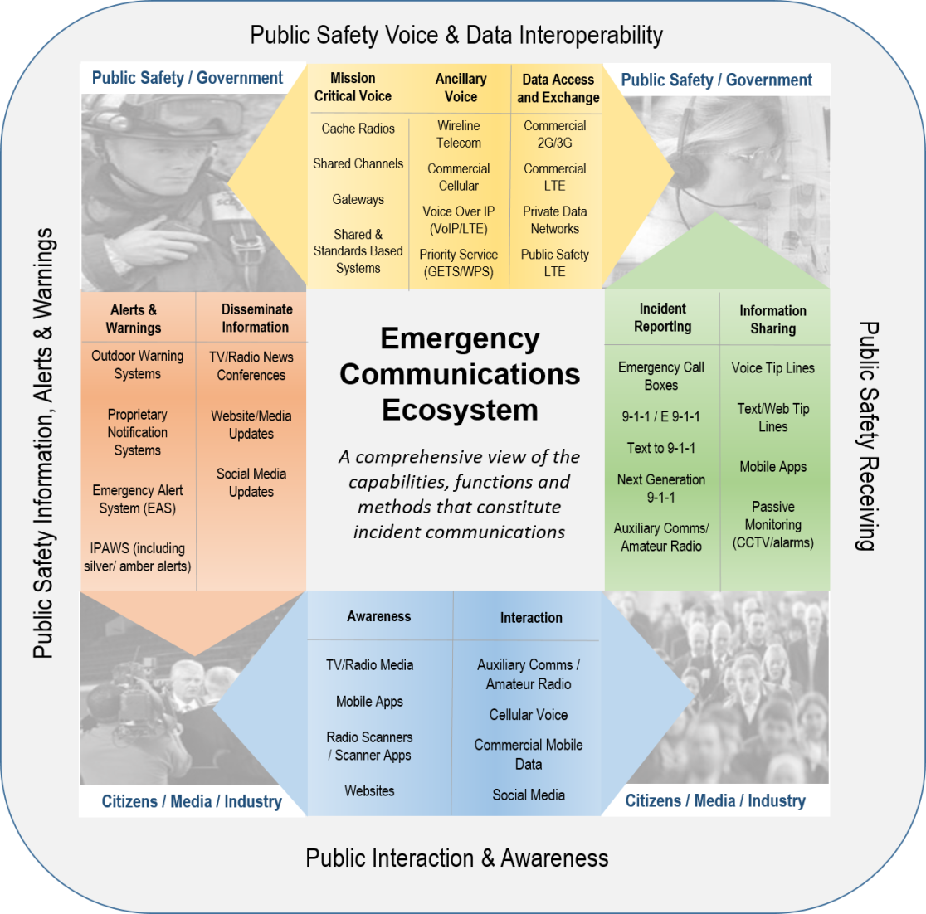
OEC Emergency Communications Ecosystem

Slide 4
Major Ecosystem Initiatives
Technical Assistance
Ecosystem TA Development Summit (Partnerships)
Bring together key executives from State and local agencies to publicize the NECP & ecosystem
Collect input/feedback on OEC Ecosystem technical assistance needs
Training / TA Sessions at State/Nationally Sponsored Conferences (External Affairs)
Governing across the Ecosystem
Operating in the Emergency Communications Ecosystem
Technology of the Emergency Communications Ecosystem
Text to 9-1-1 Prep Workshops (Partnerships)
Ecosystem in Action
Mapping the ecosystem (P&P)
Regional ecosystem tabletops (RCB)
Operational data prioritization (AAT/CPM)
Statewide Planning
Review/Alignment of SCIP with NECP & Ecosystem
Notes:
Developed in 2008, the NECP was designed to serve as an over-arching framework to enhance emergency communications nationwide.
OEC worked closely with key stakeholders at all levels of government and public safety to assess key capabilities and identify gaps.
However, that first plan was developed 6 years ago and was primarily focused on Land Mobile Radio (LMR) networks.
Technology has advanced considerably since then and public safety is becoming more reliant on newer technologies, such as NG 911 and Priority Services.
As a result, under its statutory authority, OEC reviewed the NECP, its goals and its recommendation and began the first comprehensive update of the original plan.

Slide 5
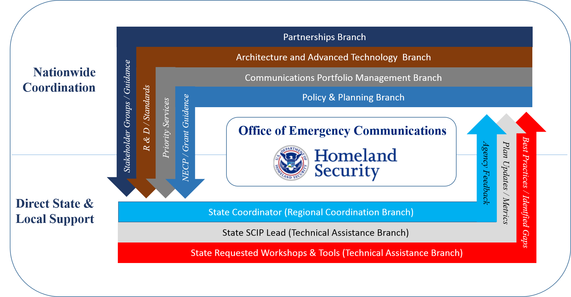
Coordinating Across OEC
Notes:
Developed in 2008, the NECP was designed to serve as an over-arching framework to enhance emergency communications nationwide.
OEC worked closely with key stakeholders at all levels of government and public safety to assess key capabilities and identify gaps.
However, that first plan was developed 6 years ago and was primarily focused on Land Mobile Radio (LMR) networks.
Technology has advanced considerably since then and public safety is becoming more reliant on newer technologies, such as NG 911 and Priority Services.
As a result, under its statutory authority, OEC reviewed the NECP, its goals and its recommendation and began the first comprehensive update of the original plan.

