Slide 1
Office of Emergency Communications
2014 Update
NPSTC Meeting – ISMA Public Safety Communications Stakeholders Forum
January 29, 2014 – 10:00-11:45 AM
Chris Essid
Deputy Director
DHS Office of Emergency Communications
Notes:
Good morning! It is great to see all of you here today. I appreciate the opportunity to provide you with an update on what OEC is working on.
2014 is going to be a big year for us and our partners in the public safety community.

Slide 2
NECP Update
OEC is updating the NECP to reflect changes in the emergency communications landscape
New technologies (broadband), policies, organizations, and stakeholders
Stakeholder-driven process that has included more than 300 stakeholders at all levels of government and the private sector
25+ stakeholder working group calls/meetings/webinars in 2013
All public safety disciplines, emergency management agencies, PSAPs, and Tribal Nations
Notes:
As many of you know, one of our major activities has been updating the National Emergency Communications Plan (NECP) – the nation’s first strategic plan – to account for the current state of interoperability nationwide and for emerging technologies, including broadband.
OEC has conducted outreach to more than 300 stakeholders involved with emergency communications from Federal, State, local and Tribal agencies, private sector and DHS representatives.
One of the key messages was to continue our focus on governance and planning and other aspects of SAFECOM’s Interoperability Continuum, but to also keep pace with policy and technology, which is continually evolving.
As a result, the updated NECP is now more strategic and conceptual than the first. The revised NECP is less rigid and places more importance on the capabilities you have identified as essential.
Another substantial change was to broaden the scope of the emergency communications community. While first responders are still the primary focus, we included more elements, such as PSAPs, CIOs and emergency management, to better reflect the overall comprehensive approach of OEC’s new mission.
While the draft is currently under review, the intent is to have the NECP finalized in the coming months.

Slide 3
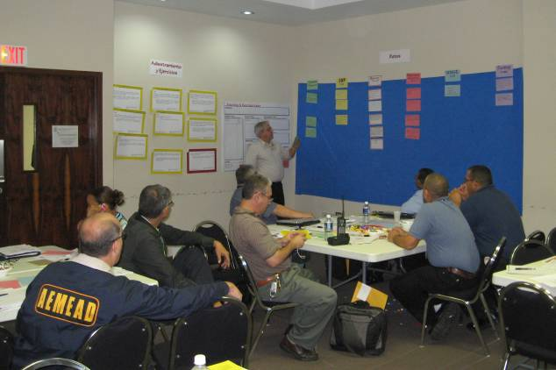
Statewide Planning Support – e-SCIP
OEC is working with all 56 States and Territories to update their Statewide Communication Interoperability Plans (SCIPs) to include new technologies
Completed 29 SCIP Workshops in 2013; more planned in 2014
e-SCIP – Online Tool developed by OEC to make SCIP update process easier
Provides a step-by-step guide to prepare a SCIP using the updated criteria, templates
Streamlines updates and aligns SCIP to pre-populate annual reports
Archives entries for long-term tracking to demonstrate progress
Notes:
We are also working with all 56 State and territories in completing the first nationwide update of their individual Statewide Communication Interoperability Plans (SCIPs).
The purpose of the ongoing updates is to help States and territories plan for new technologies, including broadband.
To assist in their efforts, OEC has been providing SCIP Workshops across the country this year. In 2013, we have conducted 29 workshops, and are planning more for this year.
We have also developed an e-SCIP Online Tool to make the SCIP update process easier. The tool follows the criteria, template, and guidance developed as part of the SCIP update process. OEC recognized the amount of time it takes to update the SCIPs.
Once fully developed, the e-SCIP will streamline the process by: providing a step-by-step process for SWICs to prepare a SCIP using the updated criteria, and will have the capability to pull data from the SCIP entry to pre-populate and begin the Annual Progress Report.
OEC presented a beta test version to NCSWIC last week. We are incorporating SWIC feedback, and plan to release it in April.
When released, the e-SCIP will be fully integrated with another online tool that OEC recently unveiled – CASM NextGen.

Slide 4
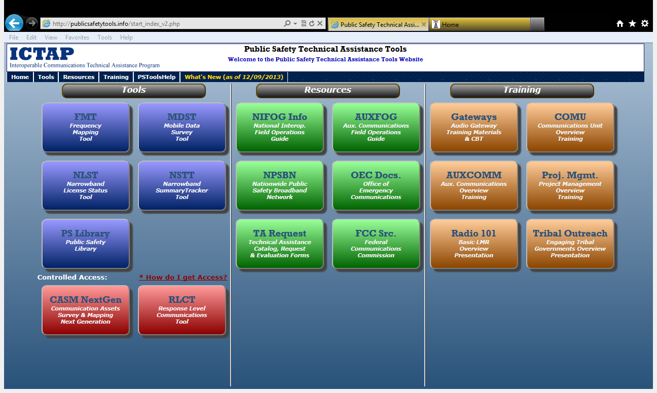
Technical Assistance – Public Safety Tools
Notes:
In addition, our Technical Assistance (TA) program has been doing some great work in providing on-site training and tools that focus on addressing State and local needs.
Last year, we completed our 1,000th technical assistance workshop. This incredible milestone is a true testament to the success of the TA program and the dedication among OEC and you, our State and local partners.
For 2014, OEC has so far accepted 170 requests for TA support, including 36 requests for broadband planning workshops.
These workshops are designed to assist States in planning for their consultation with the First Responder Network Authority (FirstNet) as it works to develop the Nationwide Public Safety Broadband Network (NPSBN).
This is our Public Safety Tools web site (www.PublicSafetyTools.info) where you can find our TA catalog and TA request forms.
As referenced earlier, our TA Branch recently unveiled a major upgrade to its Communications Assets and Mapping (CASM) Tool known as “CASM NextGen.”

Slide 5
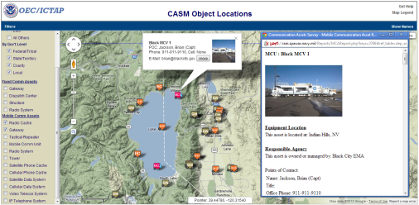
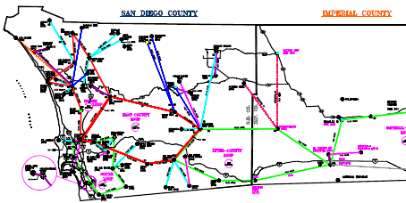
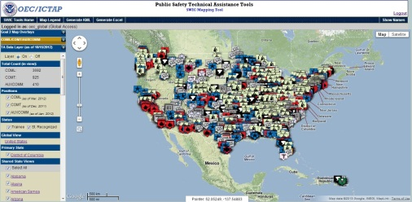
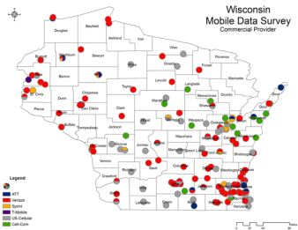
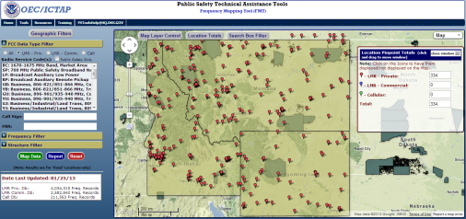
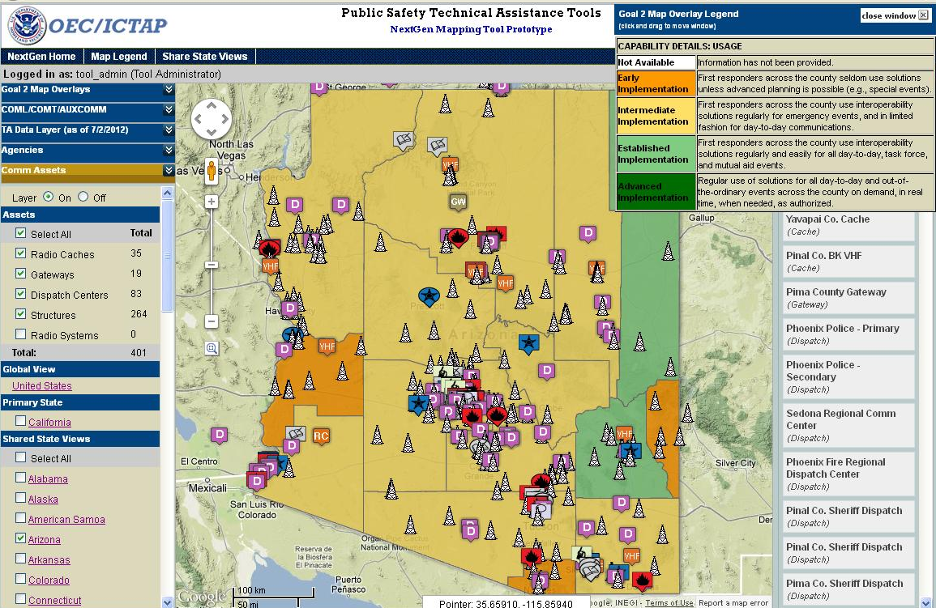
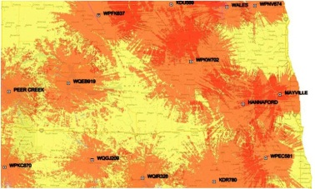
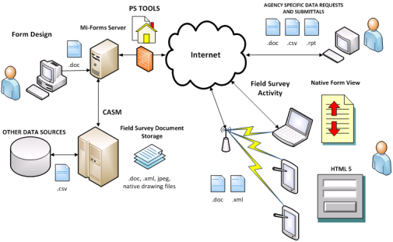
Public Safety Tools - CASM-Next Generation
www.PublicSafetyTools.Info
MCAs
Backhaul
SWIC Tools
MDST
FMT
CASM NextGen
Coverage
SST
Notes:
This dynamic new tool provides public safety with a single integrated platform to manage information about communications assets, trained COMU personnel, and TA history.
As States prepare for consultation meetings with FirstNet this year, CASM NextGen will assist them as they address data collection and analysis that we be required of them.

Slide 6
OEC Support for FirstNet, Future Users
FirstNet Board
Support for DHS FirstNet Board Member
State & Local Coordination
Support for FirstNet’s Public Safety Advisory Committee (PSAC)
Includes meeting support, administrative services, travel accommodations for in-person meetings and monthly teleconferences
Development of outreach material and project support
Federal Coordination
Emergency Communications Preparedness Center (ECPC)
FirstNet designated ECPC as its Federal coordinating body
Responsible for gathering Federal user requirements and information sharing
Coordination with Public Safety Communications Research (PSCR)
Providing technical analysis for NS/EP communications in Next Generation Networks, including OEC Priority Services (GETS, WPS)
Notes:
Another one of OEC’s main initiatives over the last year has been the office’s ongoing work with FirstNet in their efforts to develop and deploy the Nationwide Network.
OEC has taken the lead in providing policy guidance and support to Under Secretary Suzanne Spaulding, the DHS representative on the FirstNet Board.
We are also supporting State and local coordination through FirstNet’s Public Safety Advisory Committee (PSAC) by facilitating its meetings and providing related administrative services to the PSAC, its subcommittees and working groups.
OEC is also supporting Federal coordination for FirstNet through the Emergency Communications Preparedness Center (ECPC) that includes 14 Federal departments and agencies. FirstNet designated the ECPC as its Federal coordinating body, making it responsible for coordinating Federal user requirements for the nationwide network.
We are also continuing to work with the Public Safety Communications Research (PSCR) Lab in Boulder, CO, which conducts interoperability research on behalf of FirstNet, on two fronts: 1) to provide technical analysis for NS/EP communications as it evolves to Next Generation Networks (NGN), and 2) to ensure that OEC’s priority services, such as GETs and WPS, are taken into consideration during the development of the Nationwide Network.

Slide 7
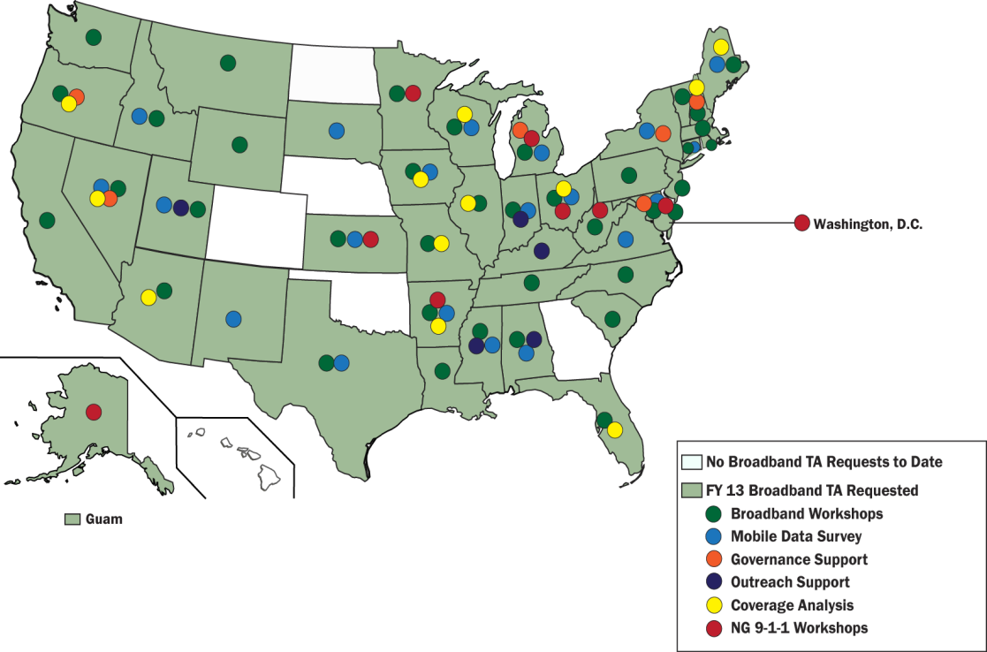
Consultation with State/Local Partners
Expansion of Statewide Plans to include NPSBN
SCIP Workshops, Update of SCIP Template/Annual Progress Report
Technical Assistance Tools and Support
More than 40 TA Engagements Nationwide
TA Offerings
- Broadband Workshops
- Mobile Data Survey
- Governance Support
- Outreach Support
- Coverage Analysis
- NG 9-1-1 Workshops
Tools
- Frequency Mapping Tool
- CASM Next Generation
- Site Survey Tool
Notes:
As referenced earlier, OEC has also been assisting State and local partners in their statewide planning efforts related to planning for the Nationwide Public Safety Broadband Network.
This includes working with them to update their SCIPs to account for broadband and other emerging technologies.
Our Technical Assistance Branch is providing various tools and workshops that are now being used to provide broadband support through more than 40 TA engagements. This map shows where are providing this support.
Our TA offerings include: Broadband Workshops, Mobile Data Surveys, Governance Support, Outreach Support, Coverage Analysis, and NG9-1-1 Workshops.
The tools that we have include the:
Frequency Mapping Tool
CASM Next Generation
Site Survey Tool.
For 2014, we have 36 requests for broadband planning workshops.

Slide 8
Notes:
It will be a busy year for us at OEC, but it will be a productive one.
Again, I want to thank you for the invitation to speak this morning regarding OEC’s programs and activities.
With that, do you have any questions?
Thank you for your time!
8

